Slide 1
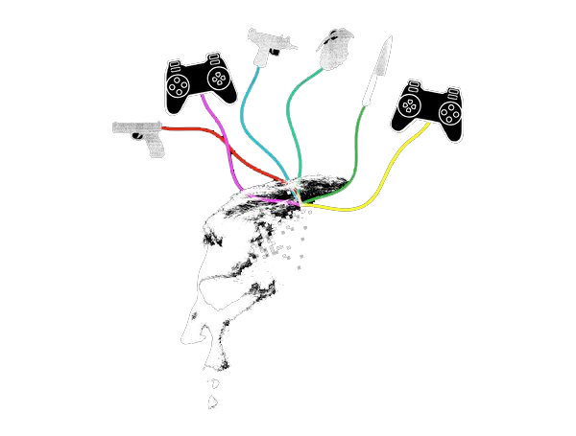
Violent Video Games and Children
Deputy Clay Cranford, School Resource Officer
CyberSafetyCop.com

Slide 2
Mass Shootings
April 20, 1999, at Columbine High School in Columbine, Eric Harris and Dylan Klebold, murdered a total of 12 students and one teacher. They injured 21 additional people, with three others being injured while attempting to escape the school.
December 14, 2012, in Newtown, Connecticut, when 20-year-old Adam Lanza fatally shot his mother, 20 children and 6 adult staff members.
September 16, 2013,lone gunman Aaron Alexis fatally shot twelve people and injured three others in a mass shooting inside the Washington Navy Yard in Southeast Washington, D.C.

Slide 3
Mass Shootings
Anders Breivik was the perpetrator of the 2011 Norway attacks. On 22 July 2011, he killed eight people by setting off a van bomb amid government buildings in Oslo, then shot dead 69 participants of a Workers' Youth League (AUF) summer camp on the island of Utøya.
Anders Breivik used his video game ‘Call of Duty’ to train for mass murder. He called it “training simulation.”

Slide 4
Linkage?
The parents of the victims killed or injured by Michael Carneal, a 14-year-old who fired upon a group of classmates at Heath High School in West Paducah, Ky., in 1997, filed suit against a host of video game manufacturers in relation to Carneal’s obsession with violent games including “Doom” and “Mortal Kombat.”
The case was dismissed in 2001, with the 6th U.S. Circuit Court of Appeals ruling that it was "simply too far a leap from shooting characters on a video screen to shooting people in a classroom."

Slide 5
Research
Review of 130,000 participants around the world.
Violent video games increase aggressive thoughts, angry feelings, physiological arousal (e.g., heart rate, blood pressure), and aggressive behavior.
Violent games also decrease helping behavior and feelings of empathy for others. The effects occurred for males and females of all ages, regardless of what country they lived in.

Slide 6
How are they bad
Violent skills are required and used by the player in order to achieve success. Violence = Pleasure
People who played first-person shooting games were more accurate than others when firing a realistic gun at a mannequin -- and more likely to aim for and hit the head.
There are no rules to prohibit killing in most cases which give the player many opportunities to harm.
With a person wanting to kill more and more, aggressive behavior tends to increase in a person.

Slide 7
Respect the ratings
EC means Early Childhood. These games are appropriate for ages 3 and older.
E means Everyone. These games are recommended for ages 6 and older.
E10+ stands for Everyone 10 and older.
T rated games are for Teens, 13 years and older.
The M means Mature and are for ages 17 and older.
AO stands for Adults Only. These games are meant for people ages 18 and older.
RP, or Rating Pending means the game is waiting for a final rating.

Slide 8
What can parents do?
Talk to your children about violent video games.
Instead of violent video games, give your children educational, interactive games that are not violent and fun.
Research games before allowing purchase. www.commonsensemedia.org
Understand the risks of allowing your child to be exposed to violence in violent video games.

Slide 9
Create balance
Use technology as a tool for promoting a charity or social cause.
Create limits. Limit the amount of time your child can be on screens (any device that has a screen) on a school night, and perhaps even the weekend.
Be the person you want your child to be. In other words, practice what you preach. Don’t bring your phone to the family dinner table. Take technology breaks and engage with your child. Board games and other structured time with the family are priceless opportunities.
Don’t be afraid to be the bad guy. Make a plan and stick to it. Boundaries are essential for your child’s safety.

