Slide 1
Health Information Exchange for Emergency Medical Services Orange County +EMS Project Update SAFR Workflow
HIE in EMS Summit
April 5, 2017

Slide 2
Objectives
Discuss the background of the project.
Discuss progress with implementing SAFR Workflow process.
Discuss HIE pilot testing phase and project outcome.
Discuss patient privacy and information security.

Slide 3
+EMS Project Background
Each participating County is to develop partnerships between one 9-1-1 EMS provider with transport capability, one receiving hospital, the Regional Health Information Organization (RHIO), and the Local EMS Agency (LEMSA).
Orange County Project Participants
EMS Provider: Newport Beach Fire Department (NBFD)
Hospital: Hoag Memorial Hospital Presbyterian
RHIO: One California Partnership Regional Health Information Organization (OCPRHIO)
LEMSA: Orange County EMS
Project Timeline: July 2015 – July 2017
Primary Project Deliverables = Implement SAFR Workflow
Primary goal is 10% of monthly EMS transport call volume includes data exchanged through the HIE network.

Slide 4
+EMS Project Implementation
NBFD Live on NEMSIS 3 Apr 2016
Q4 2016 / Q1 2017 Technical Dev.
20 medics selected to participate
All trained in Dec. 2016 / Jan. 2017
“Soft” Go-Live Feb. 22, 2017
Included “Search” and “Alert"
“Hard” Go-Live Mar. 30, 2017
Included all SAFR components

Slide 6
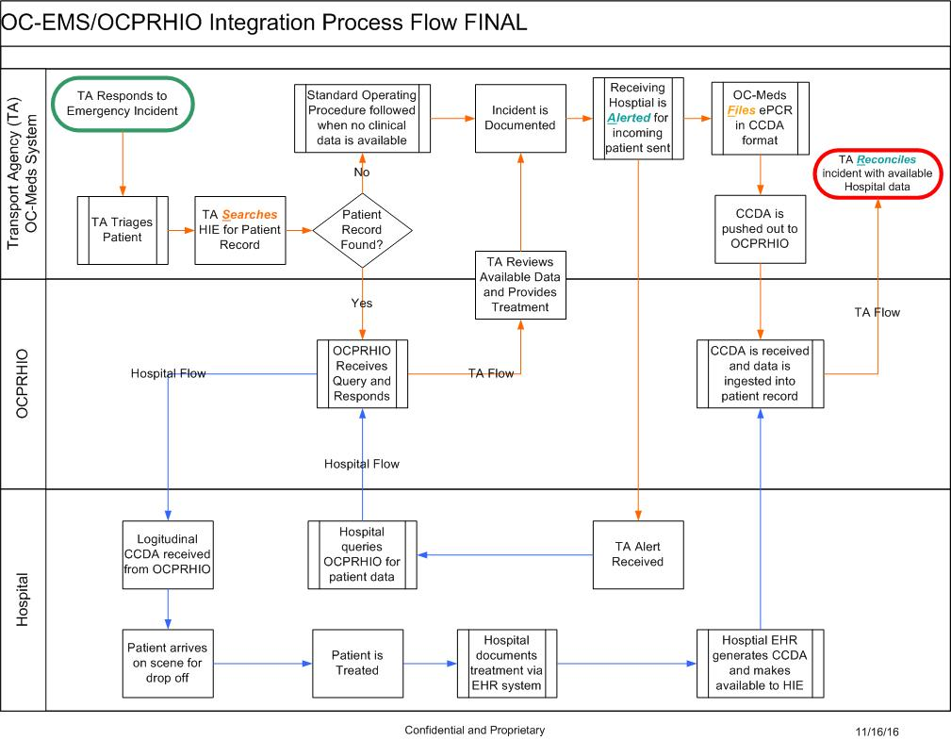

Slide 7
SAFR – Practical Considerations
Each aspect of the SAFR model has an effect on EMS patient care operations and workflow.
Practical application of SAFR will change how OC EMS providers use their ePCRs and will change how OC Receiving Hospitals receive and use EMS reports.
20 users have been identified who are best suited to test these changes. Only these users will have permissions to search the HIE.

Slide 8
SEARCH Function
Implemented Feb.22, 2017
A new interface in the ePCR embedded in the “Repeat Patient” search area allows providers to search the HIE.
Searching the HIE is a new behavior which will have to be taught.
Searching the HIE may take time.

Slide 9
SEARCH Function
The search should be conducted at some point upon patient contact, but before arrival at the hospital.
When searching the HIE, users MUST have the following four (4) patient identifiers:
First Name
Last Name
Date of Birth
Gender

Slide 10
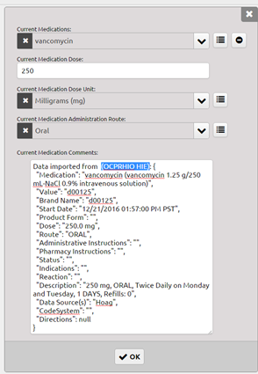
SEARCH Function
If there is a match, the user will be prompted to confirm their selection – this is called “Breaking the glass”.
“Breaking the glass” confirms that you are in fact this patients current care giver and have rights to access his/her medical records.
The search will return patient medical history, allergies, medications, and basic demographic information.

Slide 11
Search demo video (Next Slide) Video May also be viewed online at: https://youtu.be/qVKBi_tKGBY

Slide 13
ALERT Function
Implemented Feb. 22, 2017
Changes to how receiving hospitals use the existing OC Hospital Hub are underway.
Changes include an audible alert.
Receiving hospital will need Hospital Hub on a static display.
EMS providers will need to post their ePCRs prior to arrival at the hospital.

Slide 14
ALERT demo video (Next Slide) Video May also be viewed online at: https://youtu.be/j7VIv5YYKt0

Slide 16
FILE Function
ePCR must be completed in real-time while at the patients bed-side.
Provider must finalize their posted report so that it can be transmitted to the HIE in CCDA format.
Provider agency must be currently using an ePCR system which is certified compliant with NEMSIS v3 (3.4.0); In OC, the countywide system is provided by ImageTrend.

Slide 17
RECONCILE Function
Outcome information from receiving hospital to populate NEMSIS eOutcome fields in ePCR.
Predicated on accurate patient information – making search function more important.
EMS providers must learn how to compile and use outcome information to aid with improving EMS patient care and operations.

Slide 18
Patient Privacy and Information Security
Continue to use existing organizational privacy and security practices regarding patient care information.
Patients must be offered (or have access to) your Notice of Privacy Practices (NPP).
This can be done by providing them with a copy at the time of service or providing them with contact information (or a link to a website) where they can obtain this information at a later date.
If the patient is able, have them sign the ePCR and note the HIPAA Acknowledgement.
No additional explanation is necessary by EMS providers at the time of service.
After reviewing the NPP, a Patient may “opt-out” of any future disclosure of their health information.

Slide 19
Patient Privacy and Information Security
Conducting a patient search using the HIE (breaking the glass) gives access to ALL patient records countywide; not just patients seen by your organization (like with “repeat patient” searches).
It’s important to use the HIE search responsibly and never access records for any patient that is not in your immediate care.

Slide 20
Summary
This is a grant funded project designed to test real-time health information exchange between EMS providers and hospitals.
NBFD is a partner with Hoag, OCPRHIO, and OCEMS whose key role is to pilot the SAFR model for data exchange and interoperability.
Implementing the SAFR model will include some changes to how the ePCR system is currently used.
Patient privacy and information security are key components of responsible health information exchange.

Slide 21
Questions

