Slide 1
OC-Meds
Elite

Slide 2
Objectives
At the conclusion of this training, participants will be able to:
  Verbalize the rationale for transitioning to a NEMSIS 3 compliant software program
  Demonstrate the ability to complete an ePCR in Elite Field and Elite web version
  Demonstrate the ability to upload and download a transferred ePCR
  Demonstrate accessing the Agency incident list in Elite
  Note: This presentation is intended to highlight differences between Field Bridge/Service Bridge and Elite. It presents talking points for the instructor. Using the program, Elite Field, for instruction vs showing this PowerPoint presentation to field personnel may be more effective.
  Note 2: Strongly recommend devoting time orienting personnel to the tablet to be utilized if switching to a new device

Slide 3
Rationale for Transitioning to Elite
Current software is complaint with the National EMS Information System (NEMSIS) Version 2
Federal and State regulations are requiring the transition to a newer version: NEMSIS 3. California compliance is mandated by January 1, 2017
NEMSIS is consistent with international/national standards for electronic medical records (prehospital, hospital, medical offices, etc.).
There will be some new fields mandated by NEMSIS or the State that were not included in Field Bridge
This will allow for a fully integrated repository of patient medical records in the future Health Information Exchange System(HIE).

Slide 4
What does this transition mean for the future?
This transition lays the groundwork for the following:
Once a medical record is transferred to another healthcare provider, it will automatically be available in that agency’s electronic medical records
Up-to-date comprehensive patient history/information will be available to all healthcare providers
When will this integration happen? It is too early in the development/process to provide any firm time estimates

Slide 5
Elite
NEMSIS 3 dataset mandates a few new fields/data elements OC EMS providers may not have previously experienced
Elite is a relatively new program still developing and improving. Be prepared for more changes and enhancements
Examples of pending development:
  The final State of California Data Dictionary (may create the need for additional fields and modifications to our data lists)
  Jot Pad
  Cardiac Arrest Power Tool
  Active Protocols

Slide 6
Elite ePCR
3 Ways to Create an ePCR:
  www.oc-meds.org/elite: Select Elite Field Sign-In
  www.oc-meds.org/elite: Sign-in
  Click on the desktop shortcut for Elite Field

Slide 7
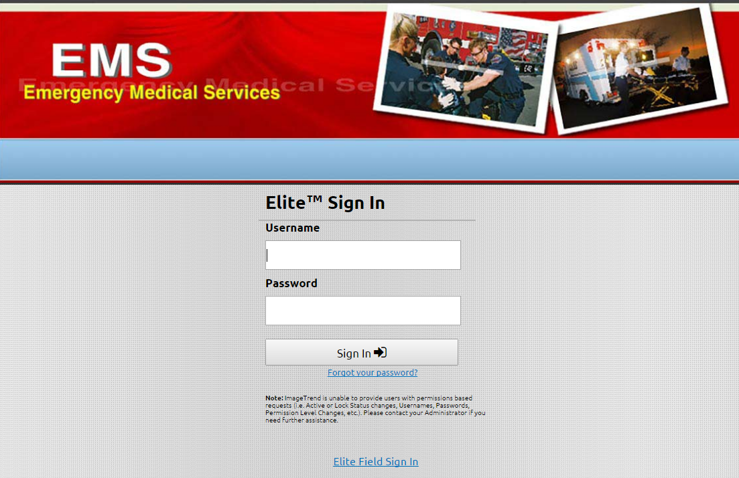
www.oc-meds.org/elite
Sign in and create the incident in the web version OR
From here the user can click Elite Field Sign In

Slide 8
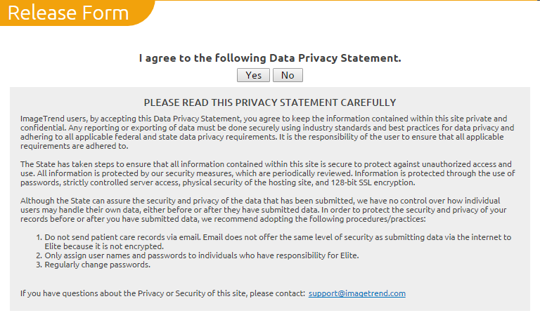
Elite (web version)
Sign in using the same user name and password utilized in Field Bridge.
Select Yes to the Privacy Statement

Slide 9
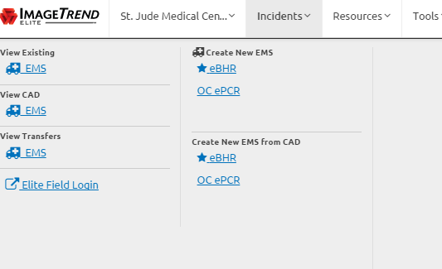
Access via the Web
Click on the incident tab
Select OCePCR (or your agency’s template) under Create New EMS
The web version is identical to Elite field with the following exceptions:
  No need to post
  Will require internet connectivity for all components of data entry
Can also navigate to Elite Field login from this page

Slide 10
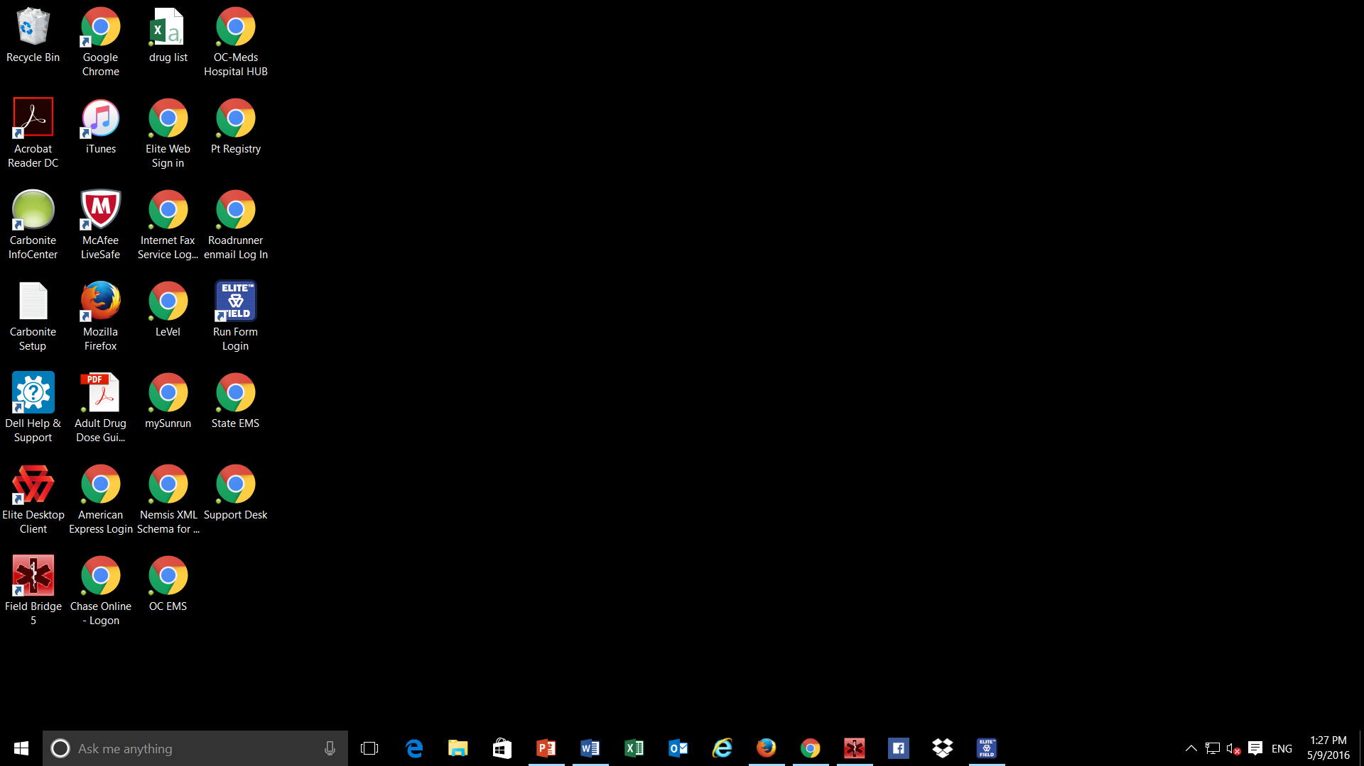
Elite Field
Locate and click on the desktop shortcut/application to go directly to the application OR
Access via the web site as illustrated in previous slides
Note: Icon may be different based on the web browser utilized

Slide 11
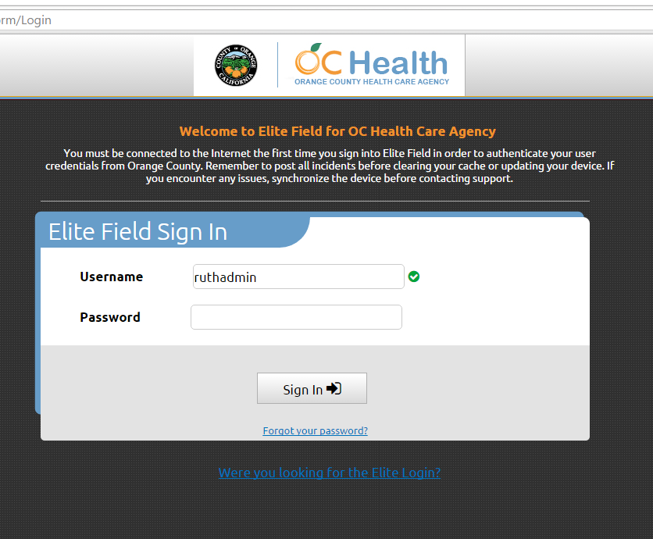
Elite Field
Sign in using same user name and password used in Field Bridge/Elite-web
Note: Internet connectivity must be present the first time a user signs-on. After the initial sign-on, internet connectivity is only necessary for posting the incident, downloading CAD data, or transferring/downloading an incident from another OC-Meds user
The green check next to the user name signifies the off-line program recognizes a user who has previously signed-on with internet connectivity present

Slide 12
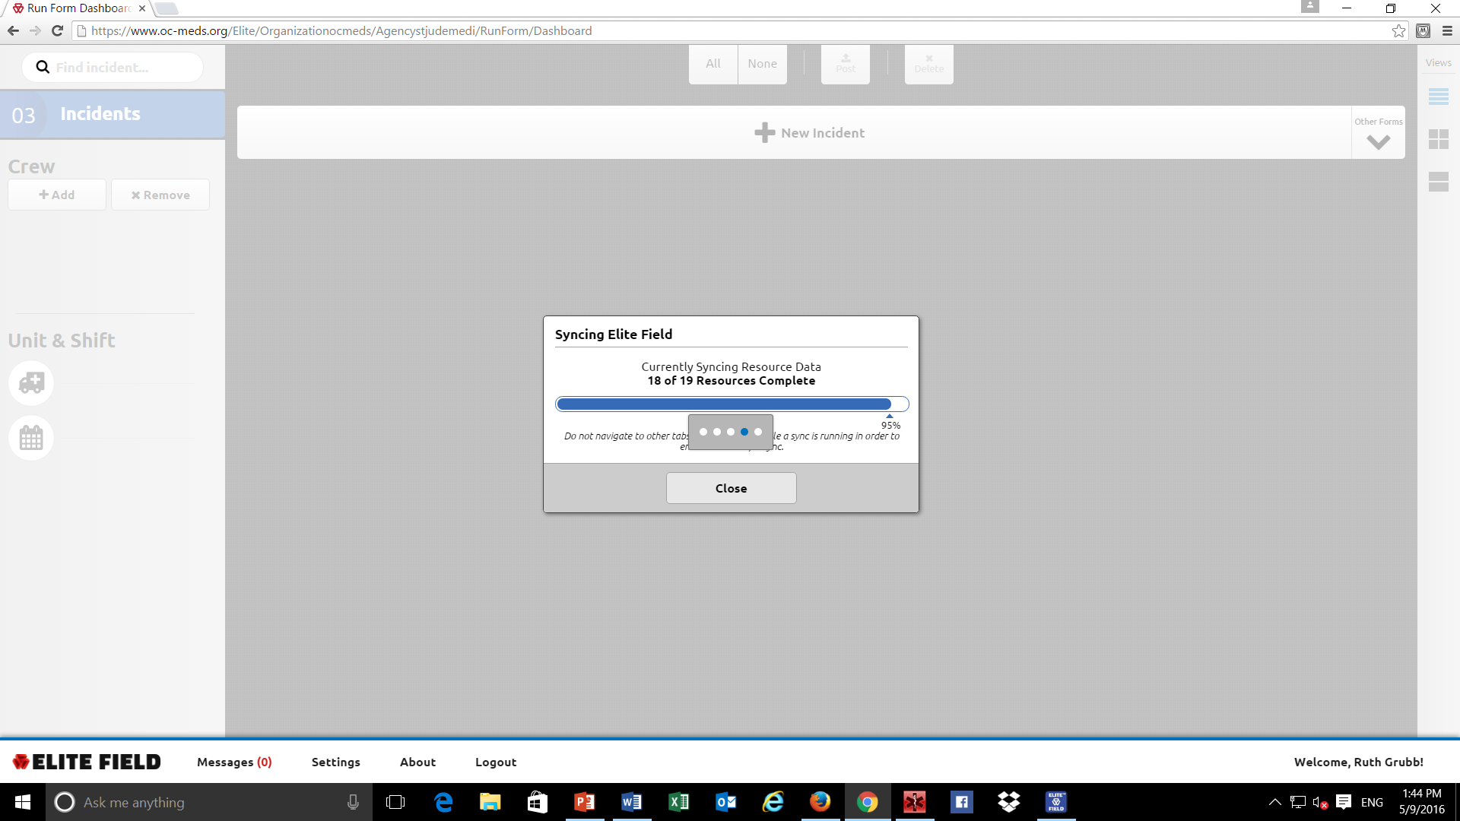
Sign-in/Auto Synch
A sync will automatically occur once Field Elite is opened: Allow this to conclude without any activity on the computer

Slide 13
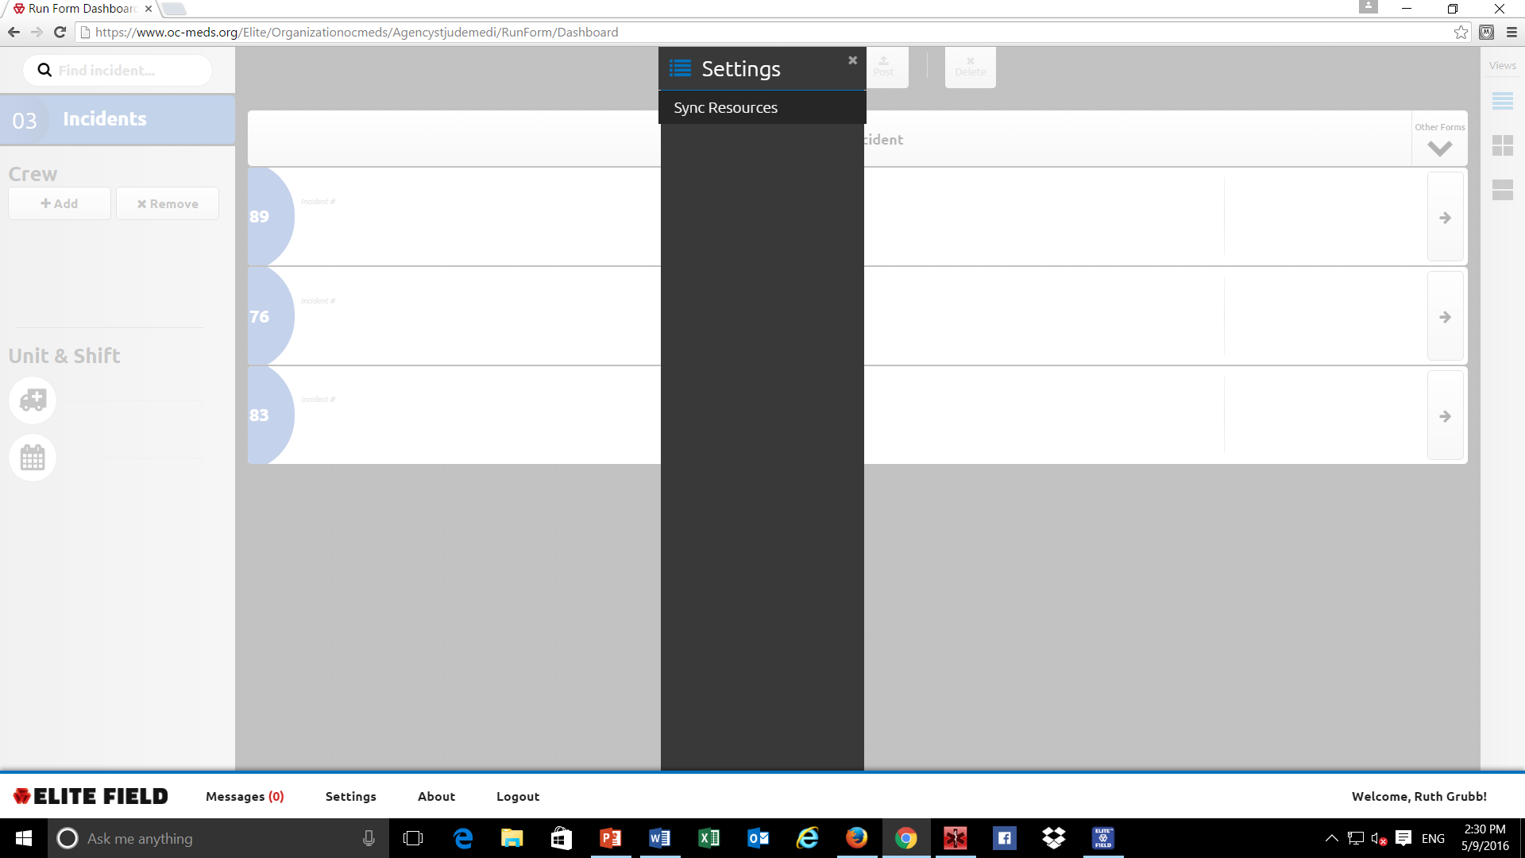
Click on Setting to manually synch.
May also access Messages (Formerly called QA/QI notes) and Logout using the selections on the bottom of the screen

Slide 14
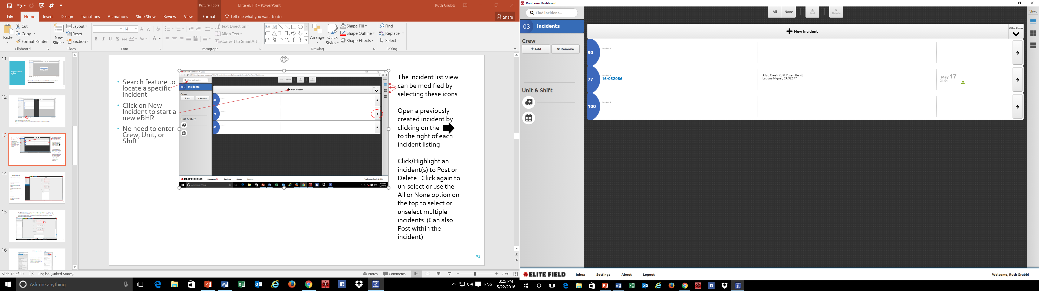
The Dashboard
The incident list view can be modified by selecting these icons
Open a previously created incident by clicking on the
to the right of each incident listing
The green up arrow-indicates a field incident has been downloaded from another OC-Meds user
Click/Highlight an incident(s) to Post or Delete. Click again to un-select or use the All or None option on the top to select or unselect multiple incidents (Can also Post within the incident)
Search feature to locate a specific incident
Enter Crew, Unit, and Shift
Click on New Incident to start a new ePCR

Slide 15
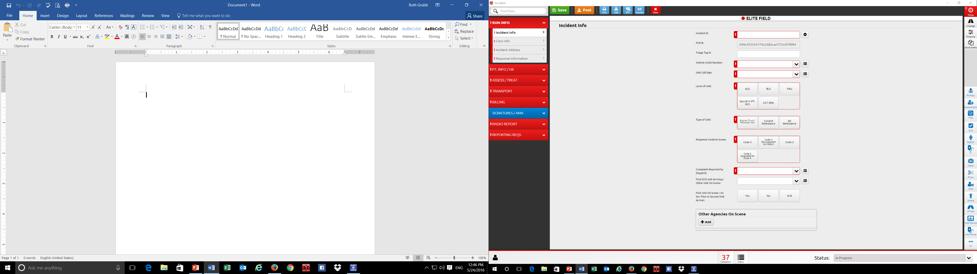
What’s Different
Tabs and Panels replaced with Sections and Panels on left side of screen
Pull Down lists vs Quick Select list
Pertinent Negatives/Null Values
Timeline replaces Treatment Pane
Grids
Validation list and Menu options on bottom of screen
Pending development/release:
Active Protocols
Jot Pad
Cardiac Arrest Power Tool
Ability to toggle between multiple patients

Slide 16
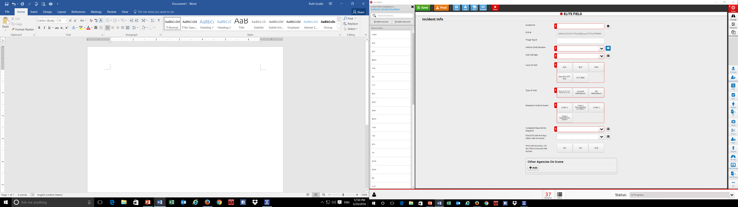
The Quick Select lists is another option, similar to the pull down lists. It places the selection options to the left of the screen, making selection for an individual holding a touch screen tablet easier. This option also allows the user to resort the list in an ascending or descending order.
If the list of options is 6 or less, then the selection possibilities will appear as labeled buttons

Slide 17
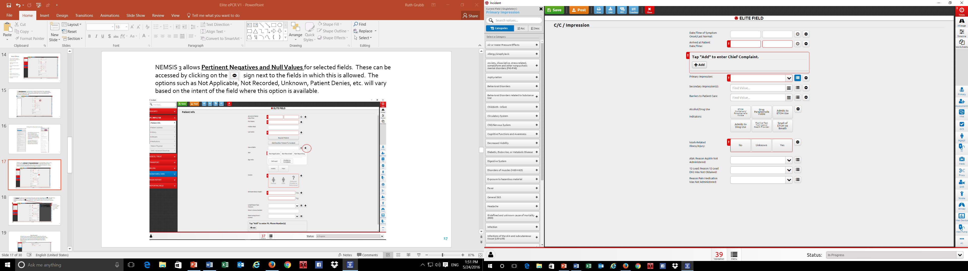
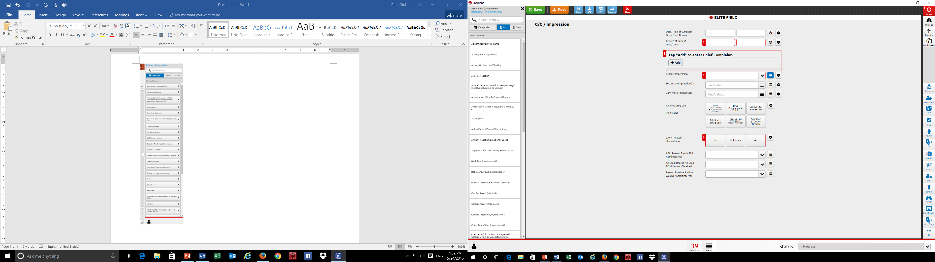
Primary/Secondary Impression List
The Quick Select List for the Primary and Secondary Impressions is extensive in NEMSIS 3. When clicking on the Quick Select Option for this field, the list will initially be organized in categories (see left screen shot). By clicking on the arrow, the list within each category will be visible. By clicking on Asc order, the list will be the more familiar listing.
The Primary Impression list is a single select. The Secondary Impression list is a multiple select field (more than one secondary impression can be documented)

Slide 18
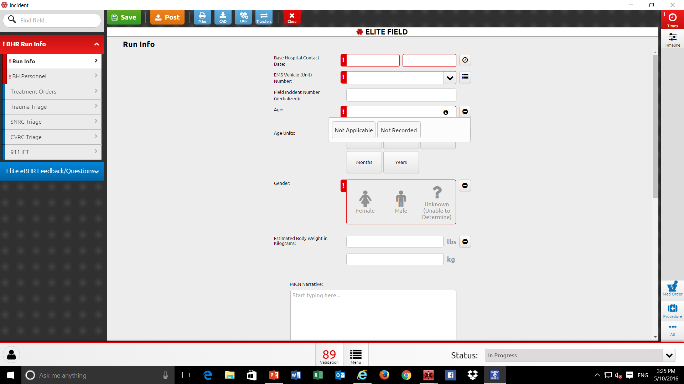
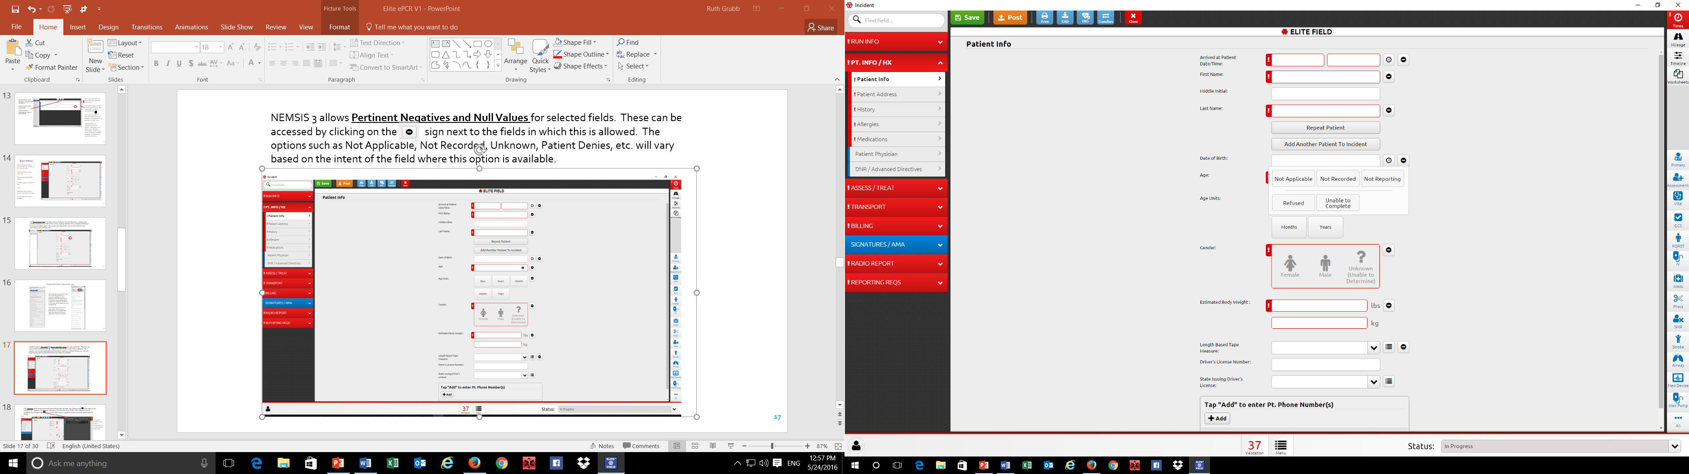
NEMSIS 3 allows Pertinent Negatives and Null Values for selected fields. These can be accessed by clicking on the sign next to the fields in which this is allowed by NEMSIS. The options such as Not Applicable, Not Recorded, Unknown, Patient Denies, etc. will vary based on the intent of the field where this option is available.

Slide 19
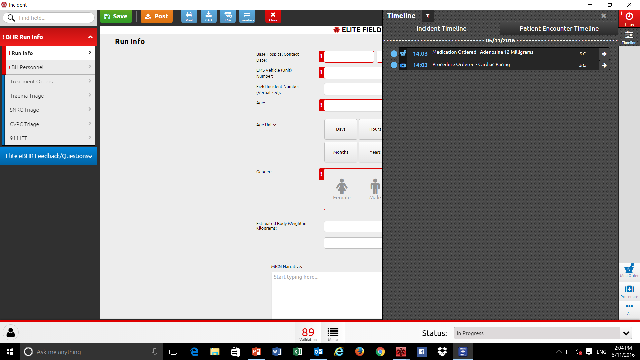
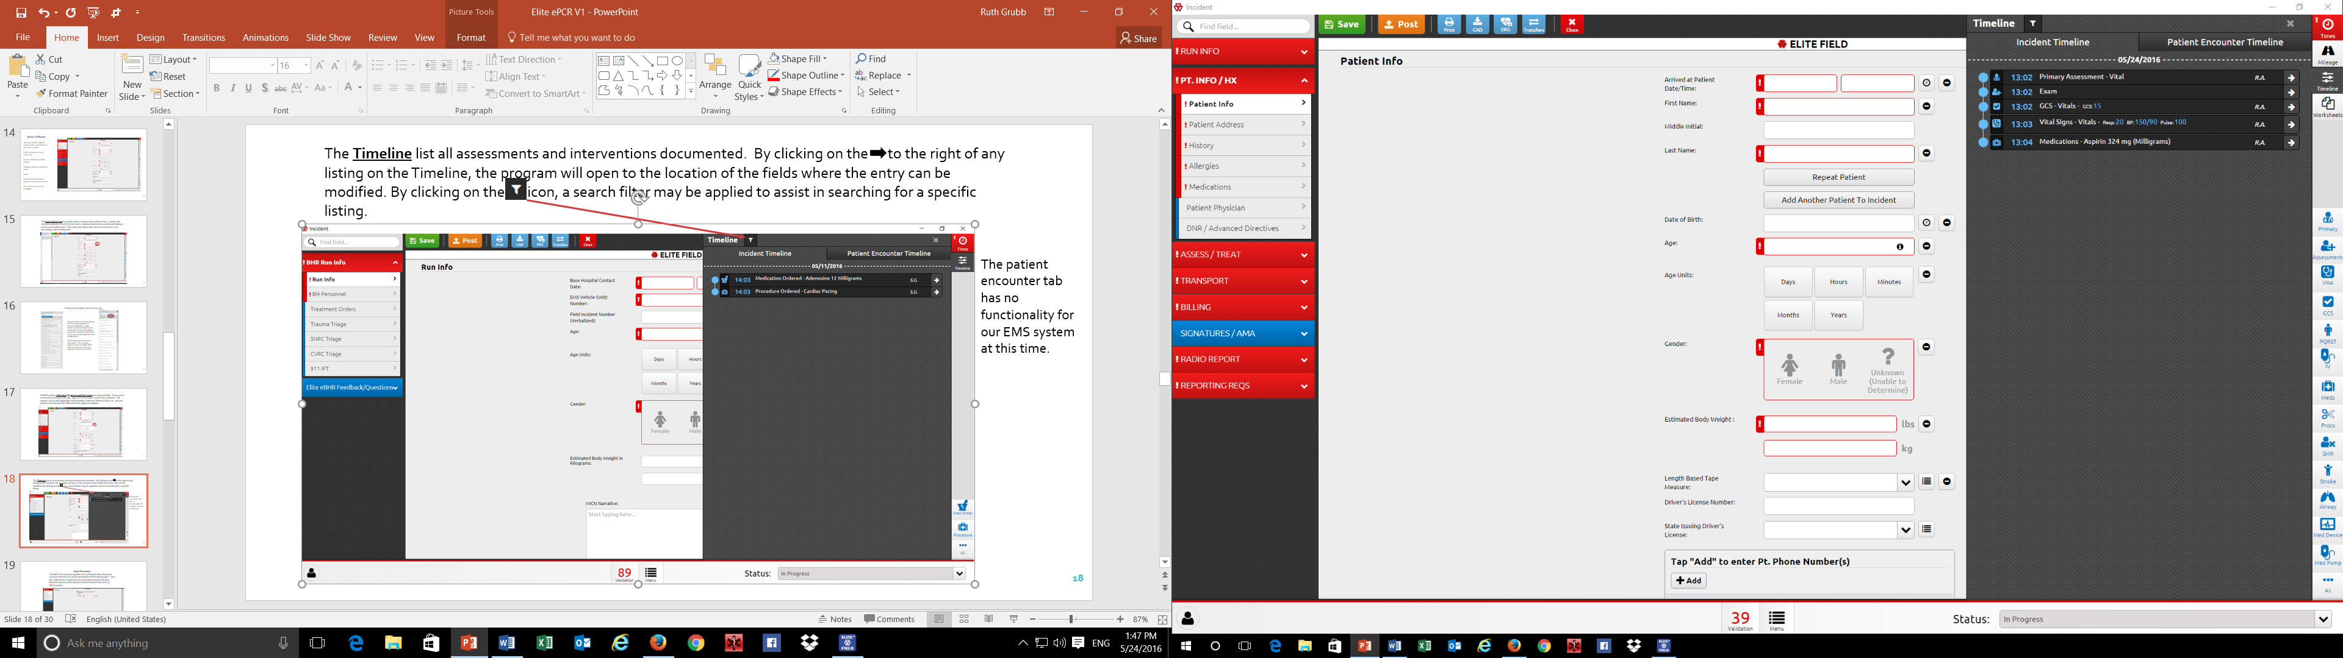
The Timeline list all assessments and interventions documented. By clicking on the to the right of any listing on the Timeline, the program will open to the location of the fields where the entry can be modified. By clicking on the icon, a search filter may be applied to assist in searching for a specific listing.
The patient encounter tab is tied into the Repeat Patient function and will list pertinent information from the previous times a patient was evaluated by a specific agency

Slide 20
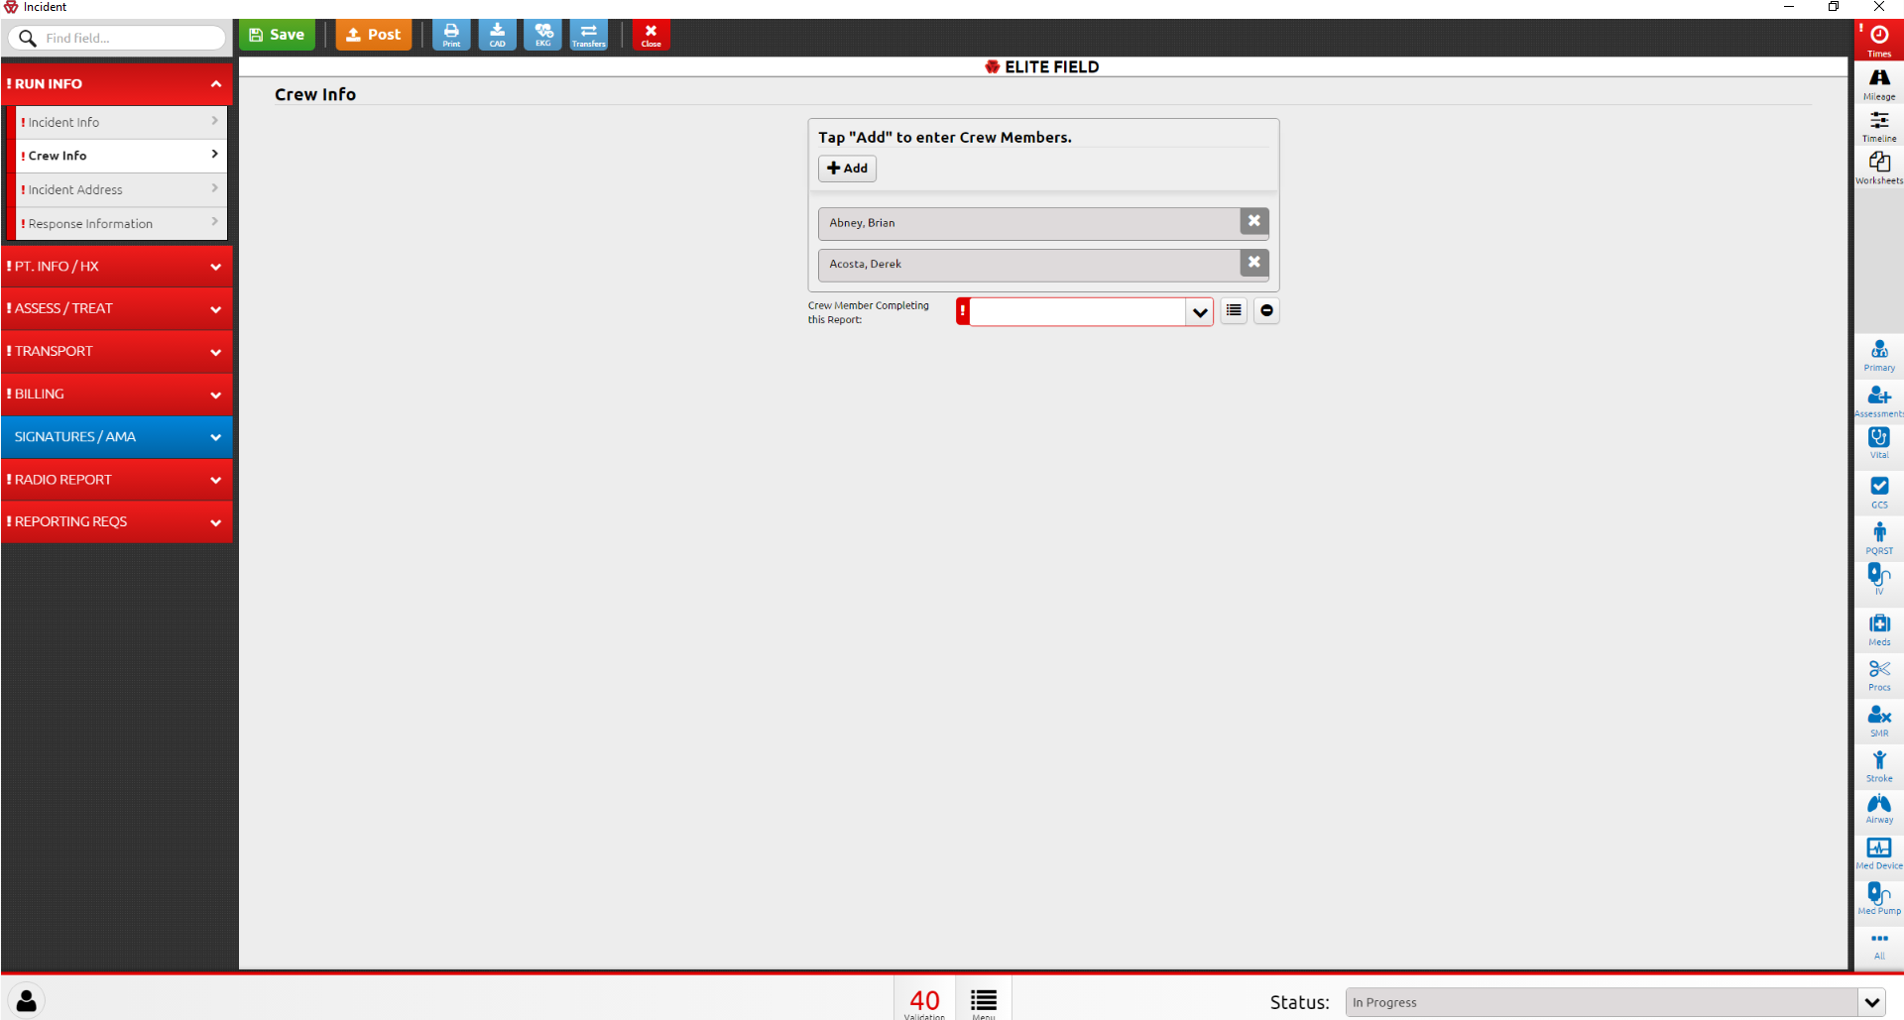
Crew Info Panel
In addition to listing all personnel assigned to the responding unit who provided care to the patient, the individual who completes the data entry must be entered by opening the Crew Info panel. The crew listed on the Dashboard can be modified by clicking the +Add button or the X (will delete the listing) to the right of the name to remove the listing

Slide 21

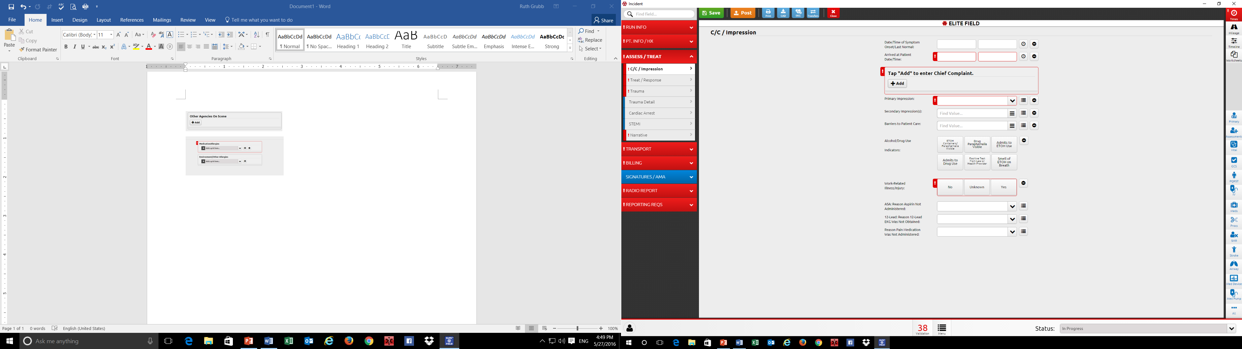
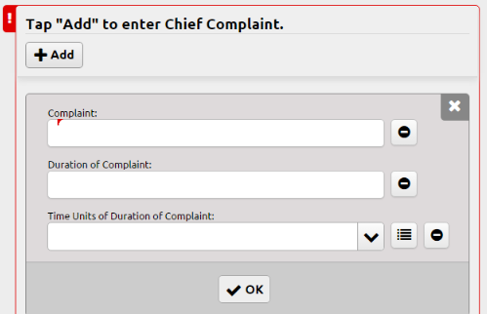
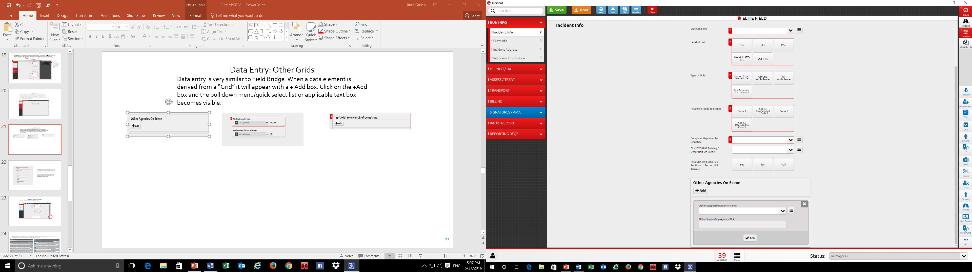
Data Entry
Data Entry: Other Grids
Data entry is very similar to Field Bridge. When a data element is derived from a “Grid” it will appear with a + Add box. Click on the +Add box and the pull down menu/quick select list or applicable text box (es) becomes visible.

Slide 22

Note: The Primary Assessment Grid will remain red until the Primary Survey assessment, one set of vital signs, and the GCS is documented.
The Secondary Assessment must include documentation of the patient’s Skin Signs and Mental Status. The remainder of the secondary assessment documentation must be specific/pertinent to the patient’s chief complaint/primary impression, MOI, medical hx, etc.
The user has the option of using the Grids for the documentation illustrated to the left or the corresponding Power Tools.

Slide 23
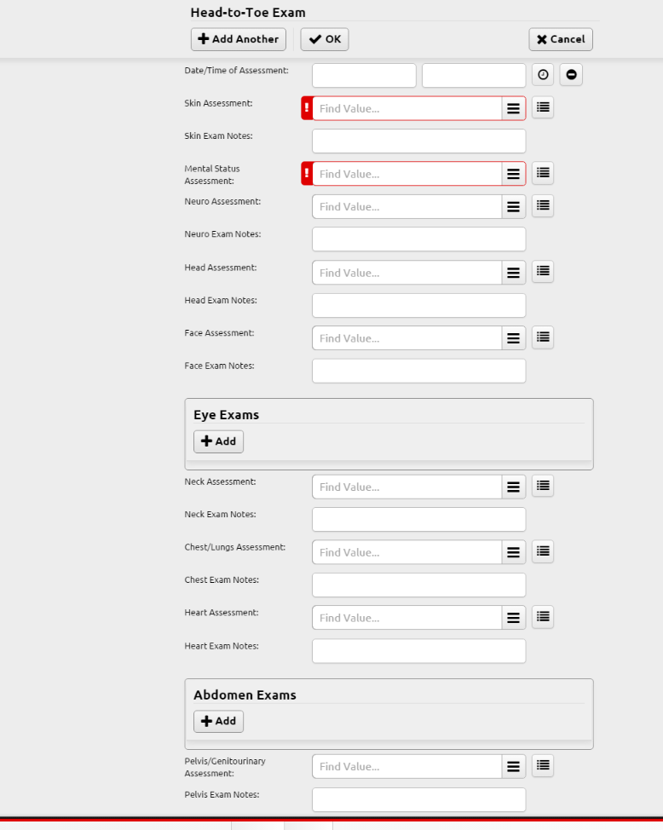
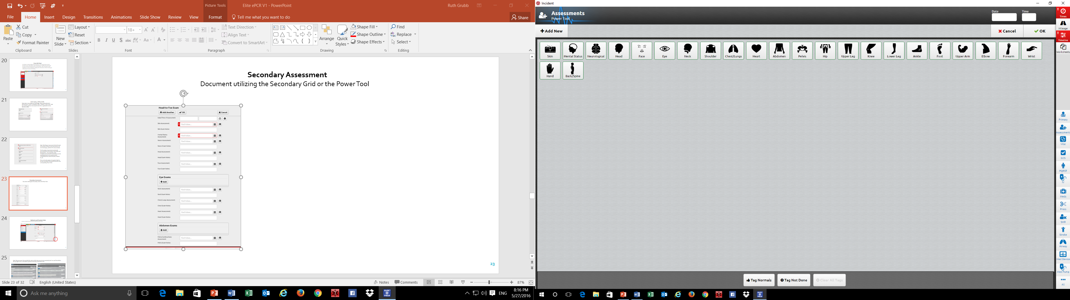
Secondary Assessment
Document utilizing the Secondary Assessment Grid or the Power Tool
Click on the pertinent category to enter assessment findings. For normal findings, may select the Tag Normal button and then click on the body area/system that is WNL

Slide 24
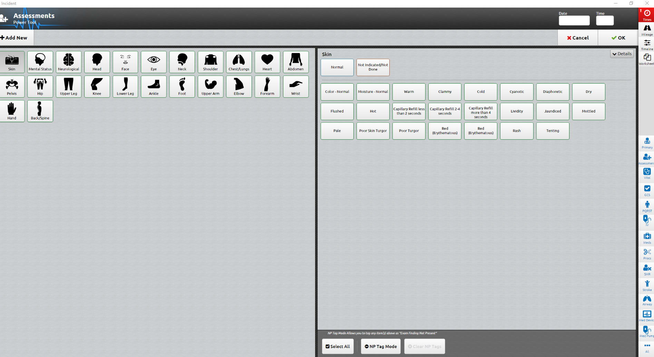
Document the time the assessment was performed
Click on the body area/system assessed to select the specific findings
Click on Details to add a narrative for clarification as indicated
Not Pertinent option is available
Click OK when complete

Slide 25
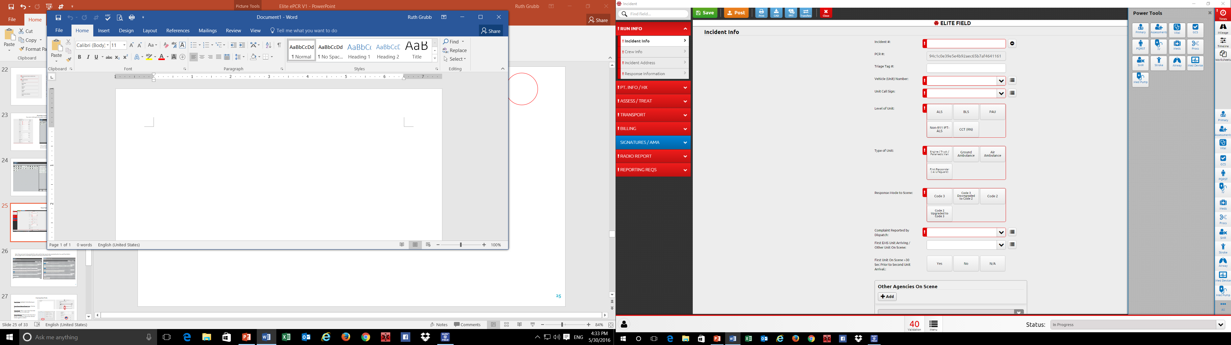
Power Tools
To see all the Power Tools available, click on All

Slide 26
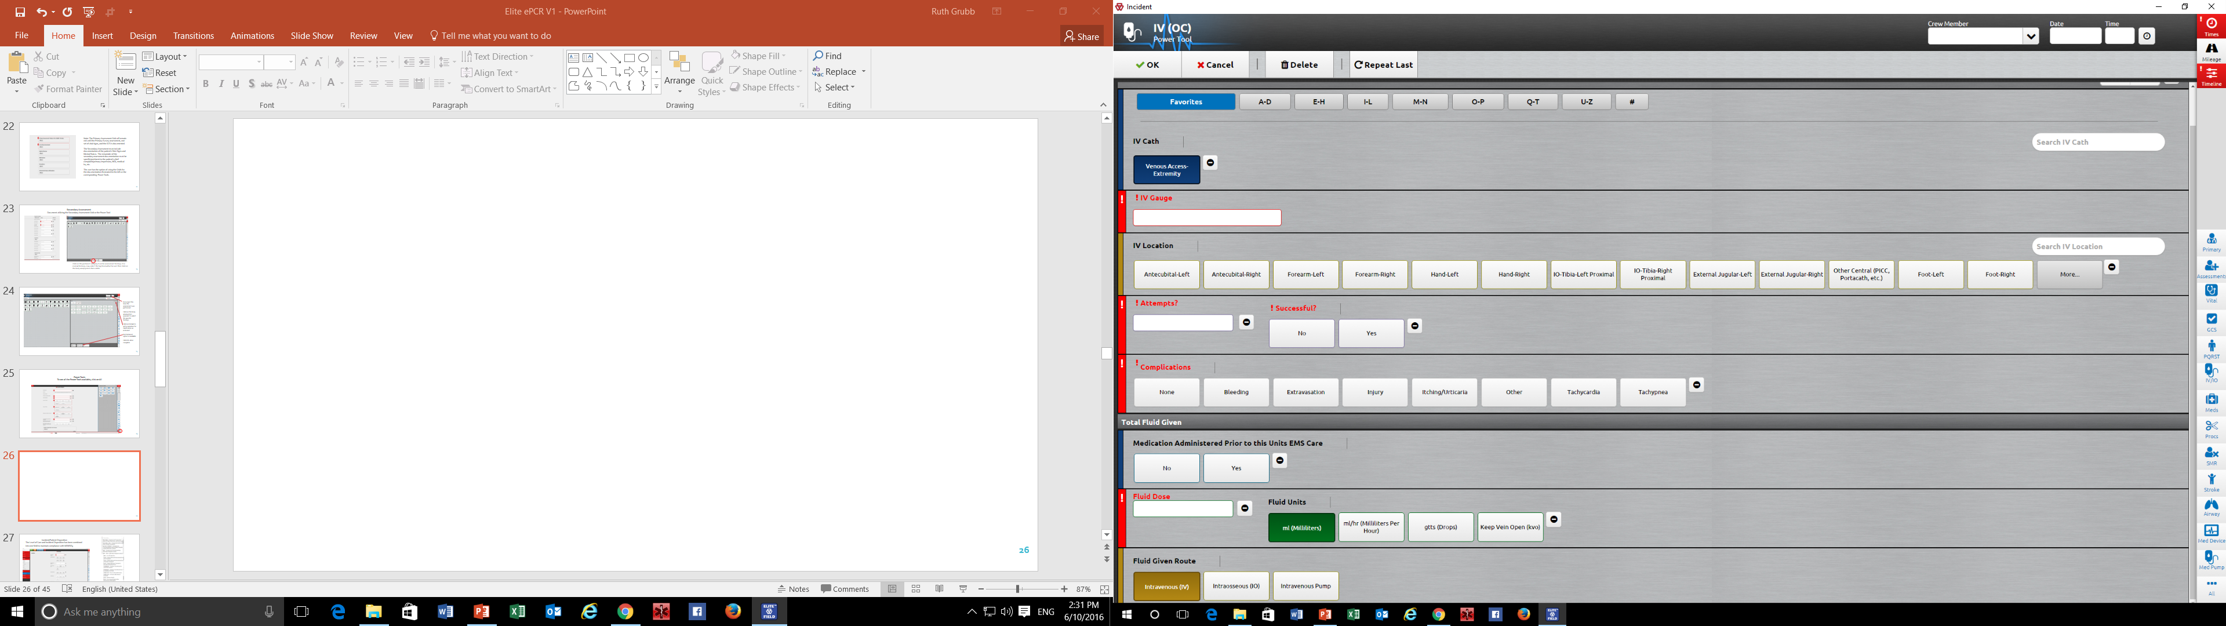
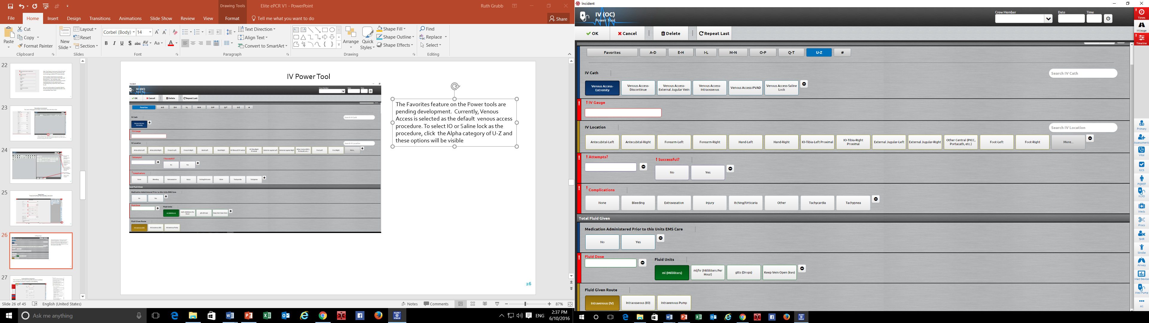
IV Power Tool
The Favorites feature on the Power tools are pending development. Currently, Venous Access is selected as the default venous access procedure. To select other venous access options, e.g. IO or Saline lock, click the Alpha category of U-Z and these options will be visible.
If the venous access attempt was unsuccessful, or a saline lock is inserted, the fluid dose validation can be satisfied by using the NV/PN option next to the Fluid dose field:

Slide 27
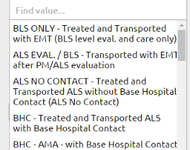
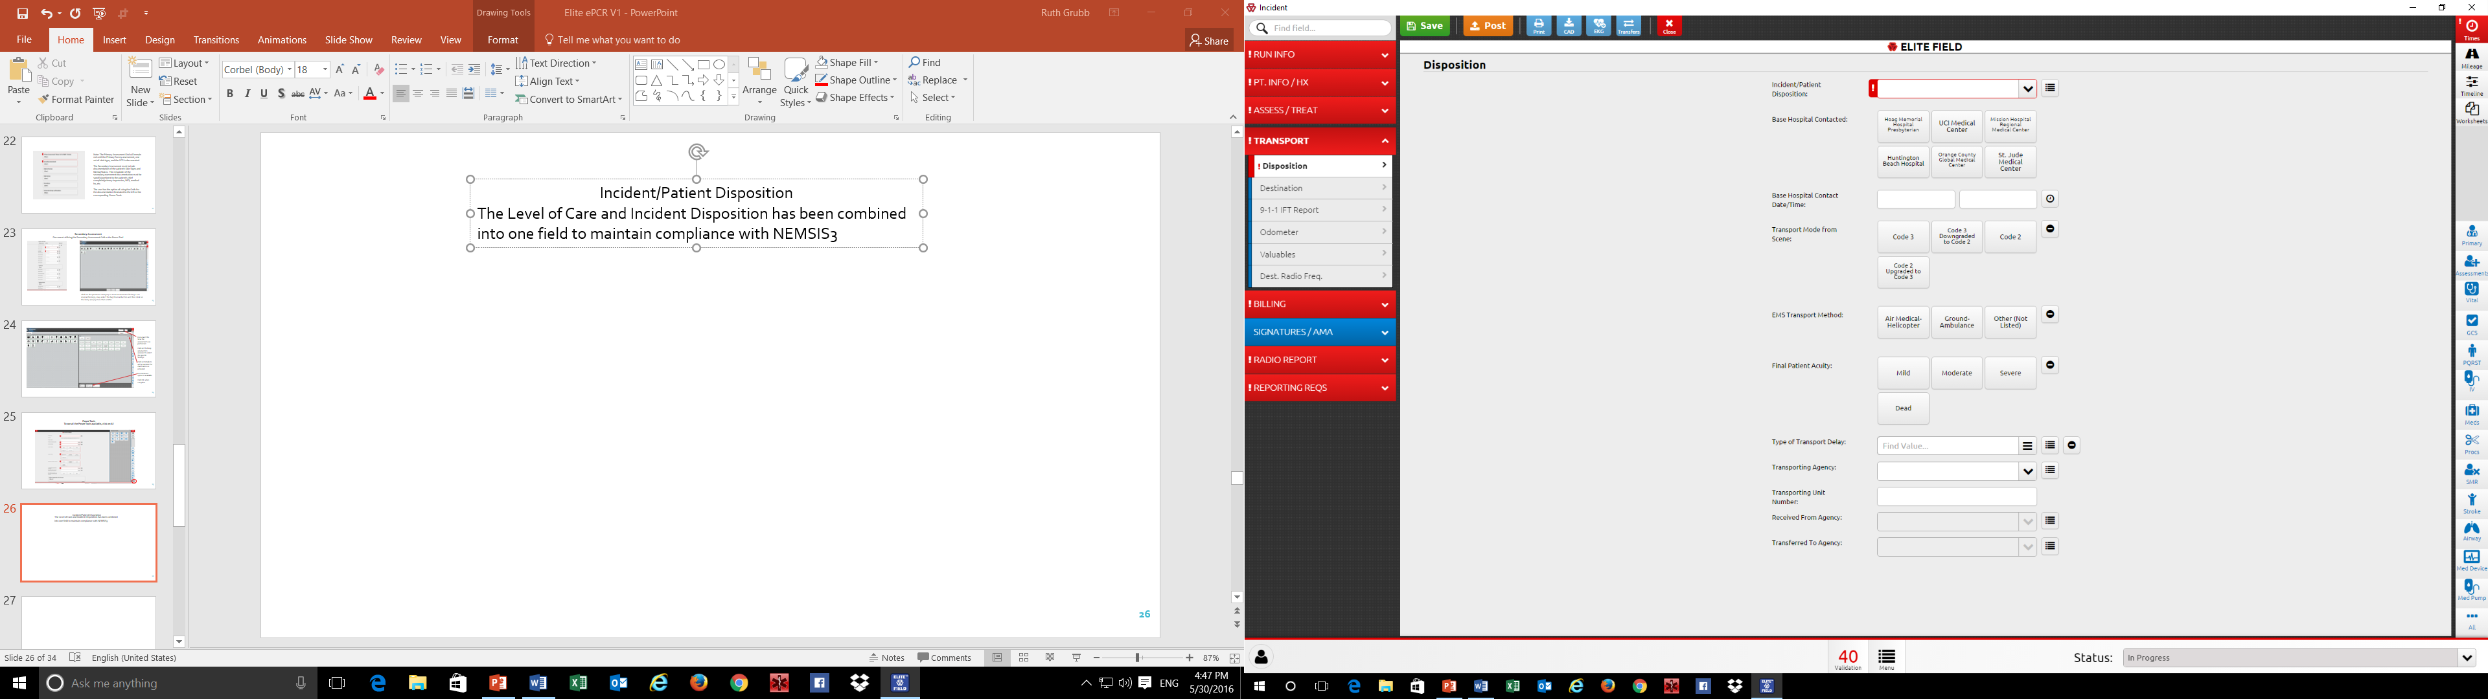
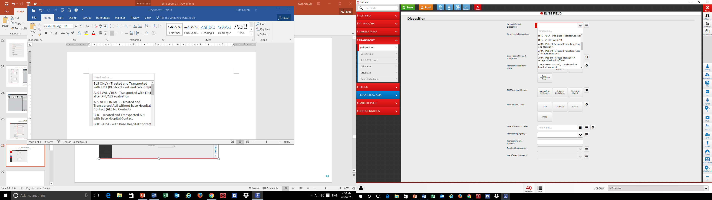
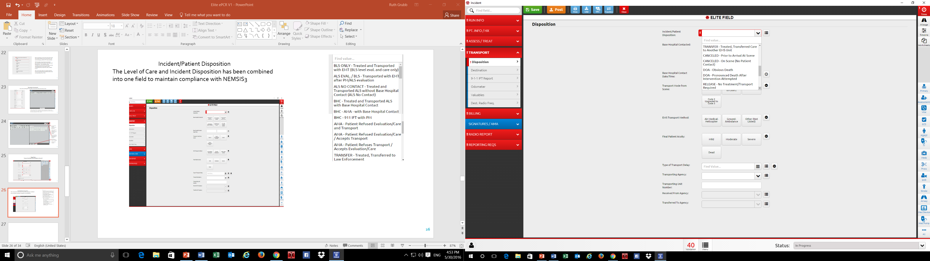
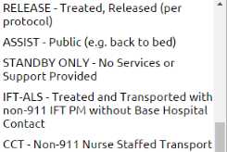
Incident/Patient Disposition
The Level of Care and Incident Disposition has been combined into one field to maintain compliance with NEMSIS3

Slide 28
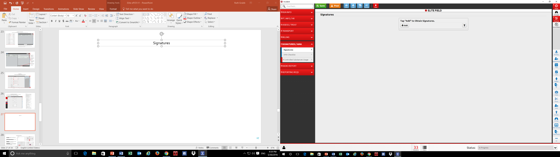
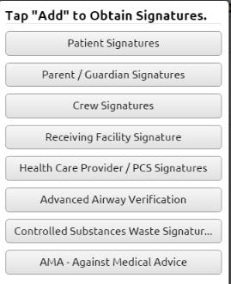
Signatures
To add a signature, click on the Signature panel and select +Add. Next, select the appropriate person or reason a signature is being obtained

Slide 29
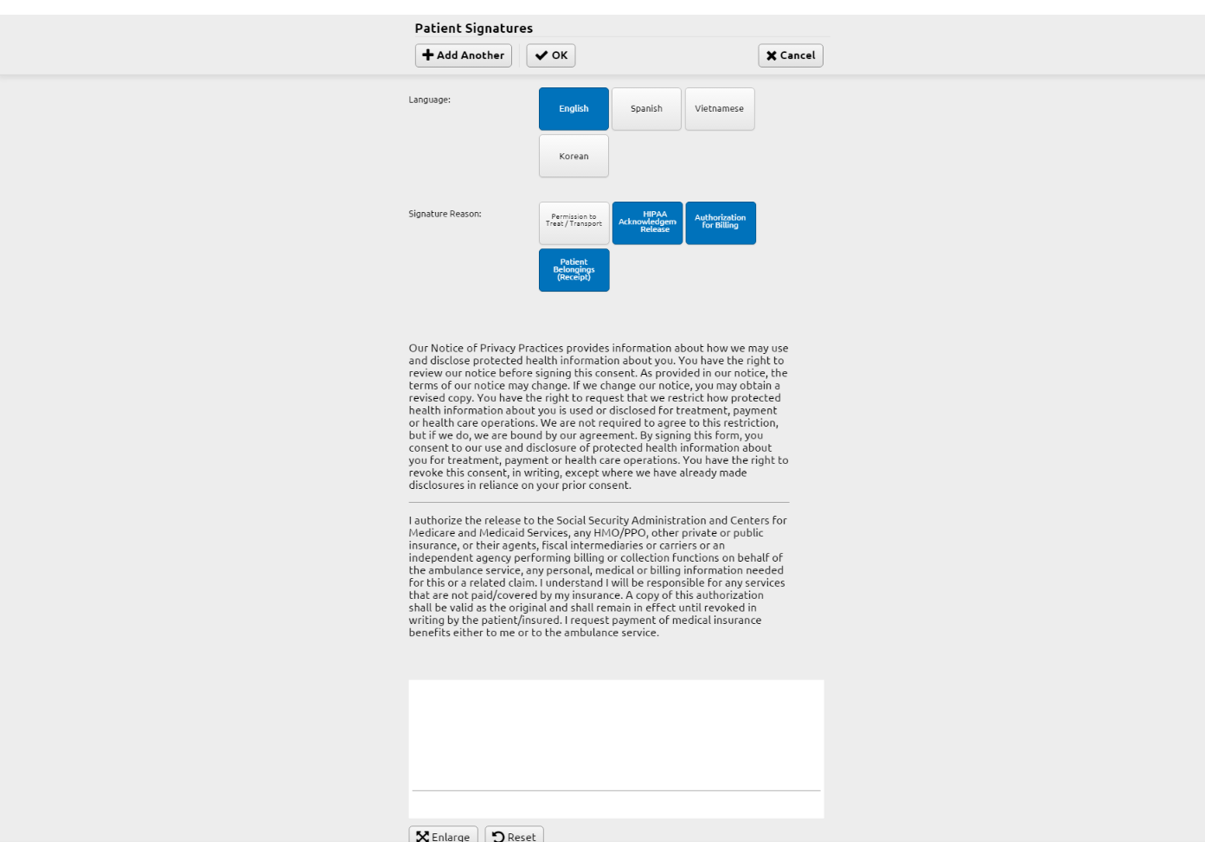
English, Spanish, Vietnamese, and Korean translations are available
Select the reason the signature is being obtained and complete the other data fields indicated
Note: AMA signature and checklist will be validated if an AMA Disposition is selected

Slide 30
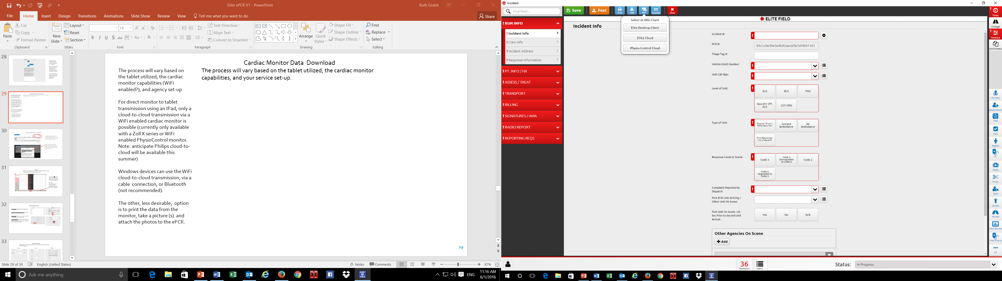
If an IPAD is utilized, then only the clout-to-cloud integration is possible with a WiFi enable cardiac monitor
Cardiac Monitor Data Download
The process will vary based on the tablet utilized, the cardiac monitor capabilities, and your service set-up.
Once the monitor data has been uploaded to the cloud, click on the EKG icon and select the import method.
The process will vary based on the tablet utilized, the cardiac monitor capabilities (WiFi enabled?), and agency set-up
For direct monitor to tablet transmission using an IPad, only a cloud-to-cloud transmission via a WiFi enabled cardiac monitor is possible (currently only available with a Zoll X series or WiFi enabled PhysioControl monitor. Note: anticipate Philips cloud-to-cloud will be available this summer)
Windows devices can use the WiFi cloud-to-cloud transmission, or a cable connection, or Bluetooth (not recommended).
The other, less desirable, option is to print the data from the monitor, take a picture (s) and attach the photos to the ePCR.
Your monitor vendor will assist with the desired monitor to tablet set-up

Slide 31
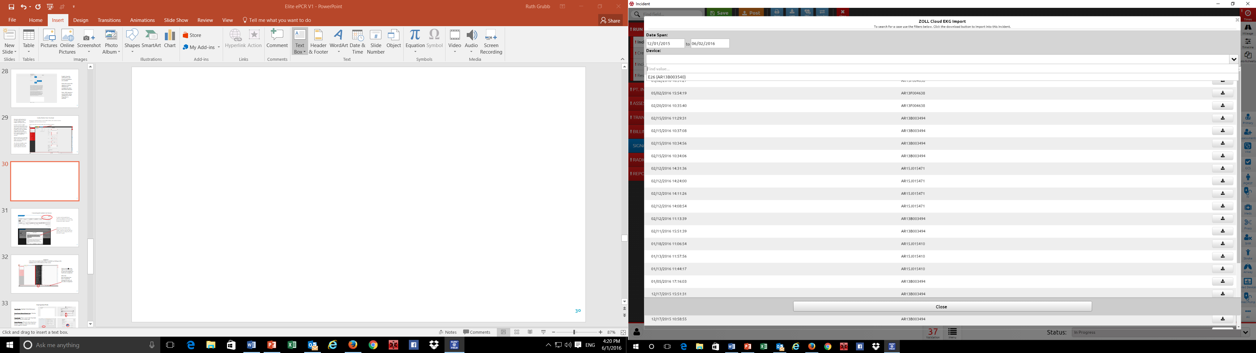
If a cloud-to-cloud download has been set-up, the list of monitor data will be available. The list can be narrowed by date and device selection. The data will be downloaded into the incident by clicking on the to the right of the listing

Slide 32
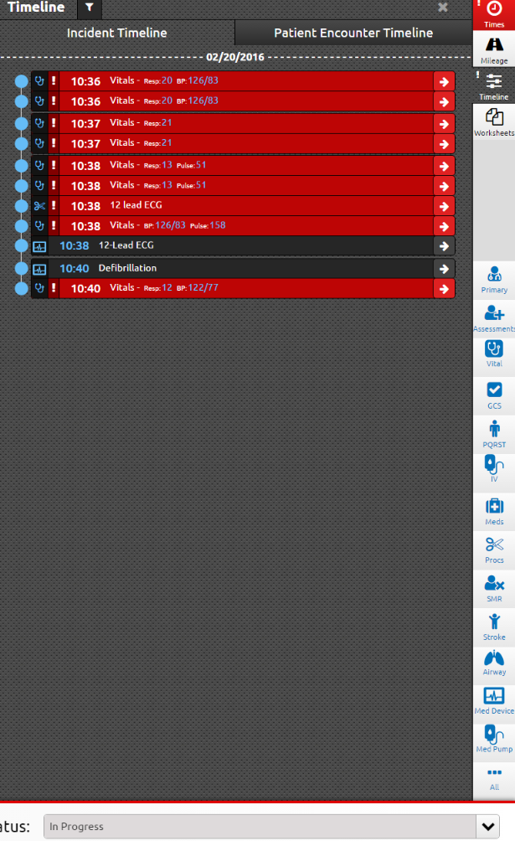
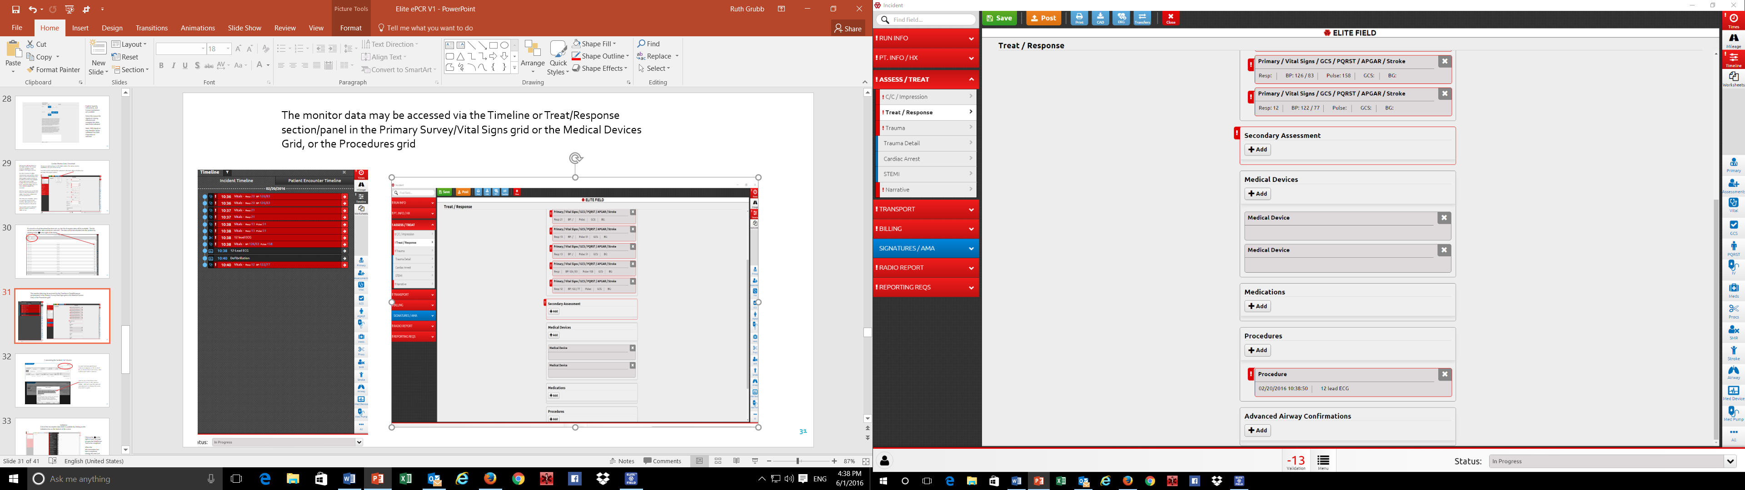
The monitor data may be accessed via the Timeline or Treat/Response section/panel in the Primary Survey/Vital Signs grid or the Medical Devices Grid, or the Procedures grid

Slide 33
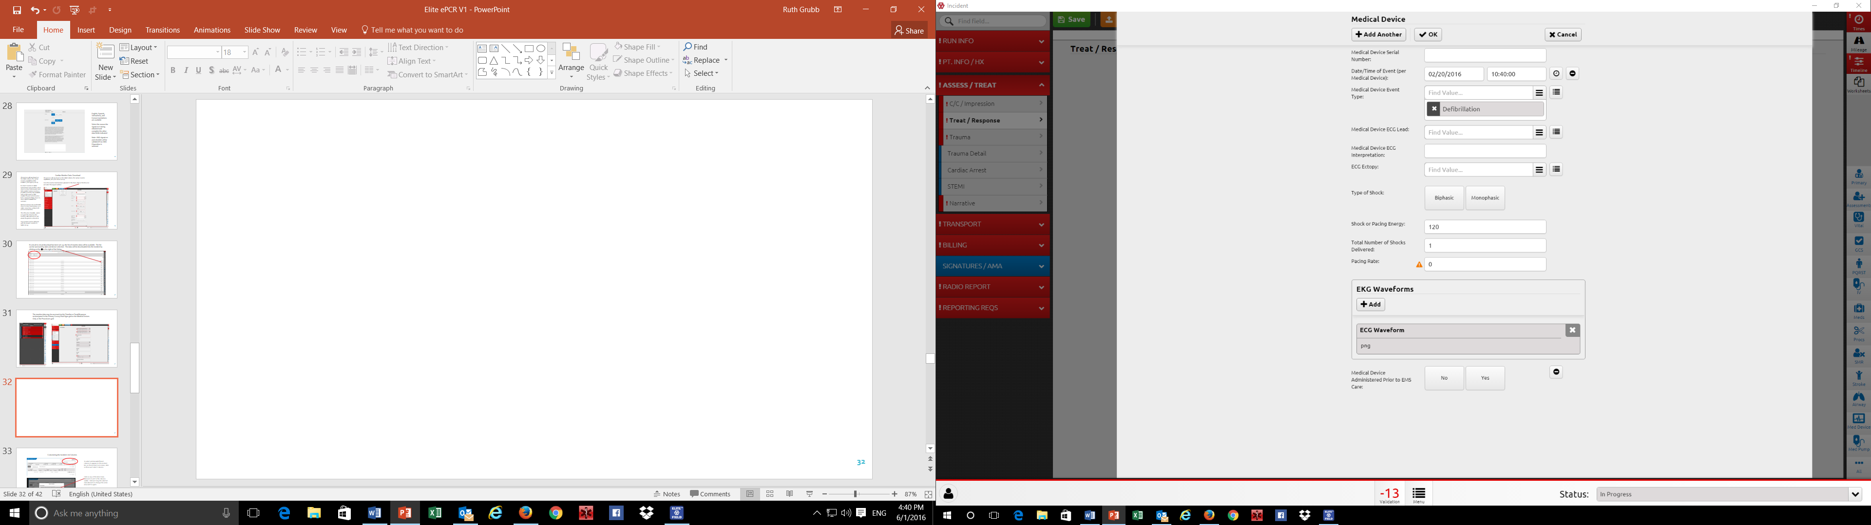
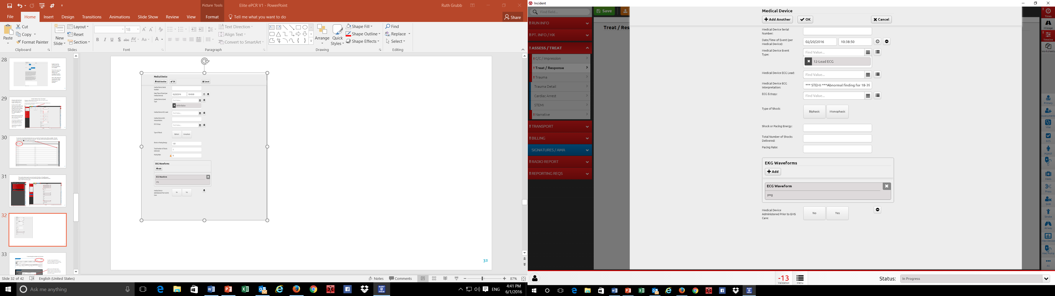
On a device with a Windows OS, the ECG Waveform and 12-Lead may be selected a viewed from the ePCR. On an IPad, the rhythm strips and 12-lead may be viewed by opening the PDF (the IPad does not support viewing a .png file)

Slide 34
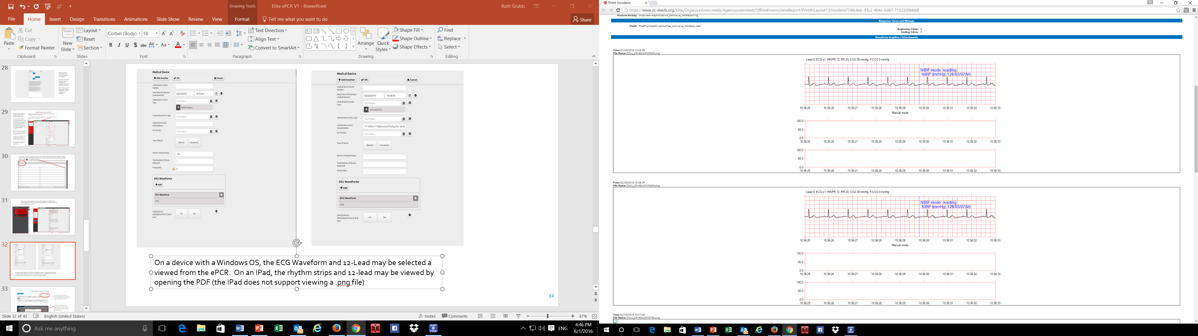
PDF with the rhythm strip from the monitor download

Slide 35
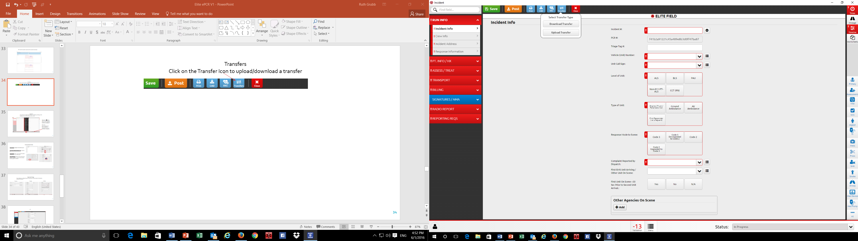
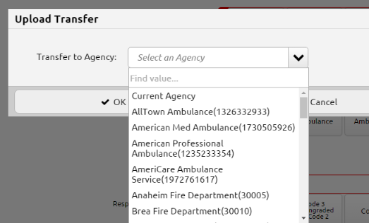
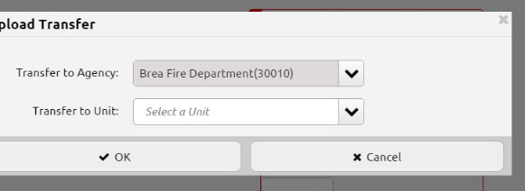
Transfers
Click on the Transfer Icon to upload/download a transfer
If transferring an incident to a unit within the same agency, select Current Agency
Once, the agency is selected, the Unit list specific for the selected agency will be available

Slide 36
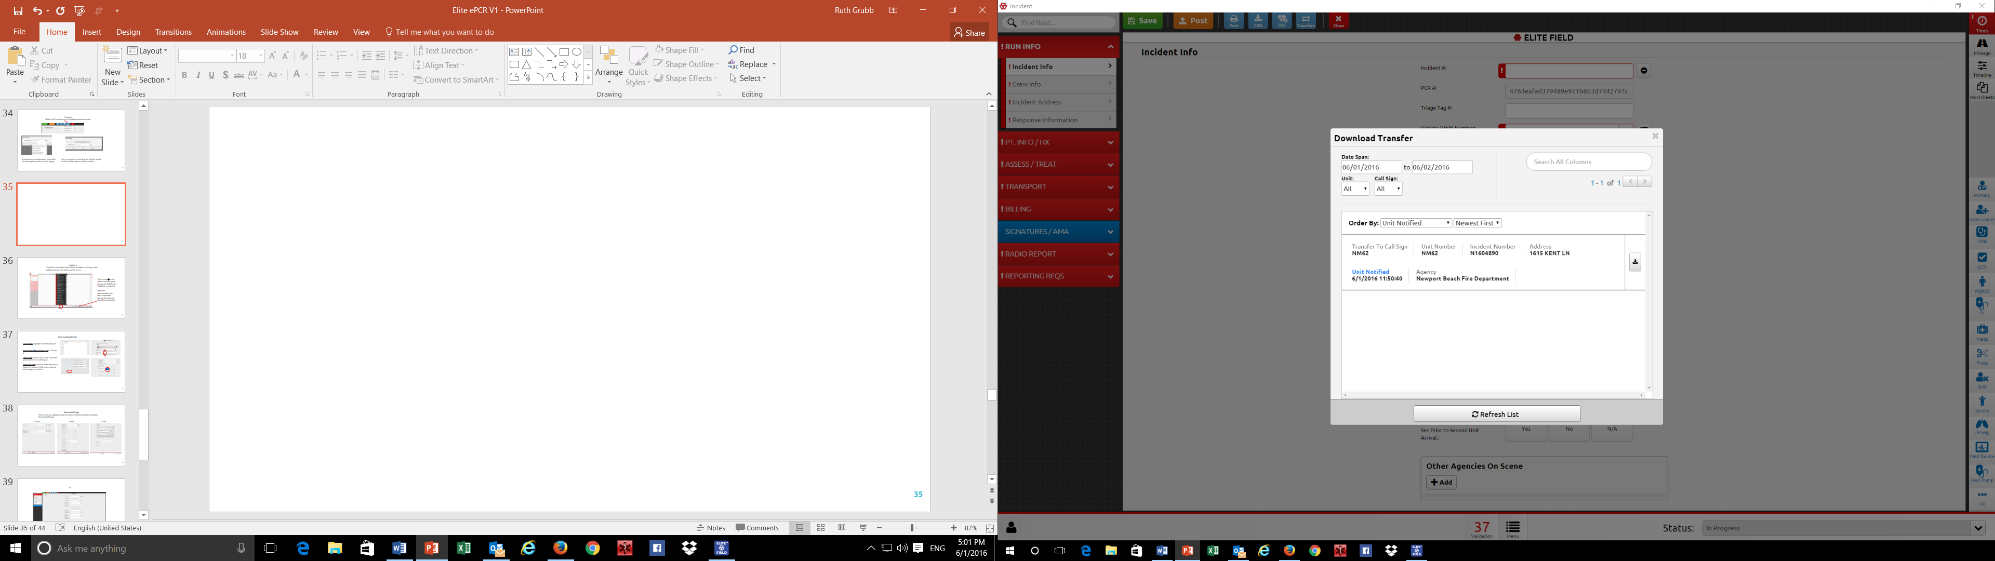
Selecting a transferred call to download is accomplished by selecting Download Transfer from the Transfer Icon and clicking on the down arrow of the appropriate call
The list may be narrowed by date, unit number or using the Search All Columns option

Slide 37
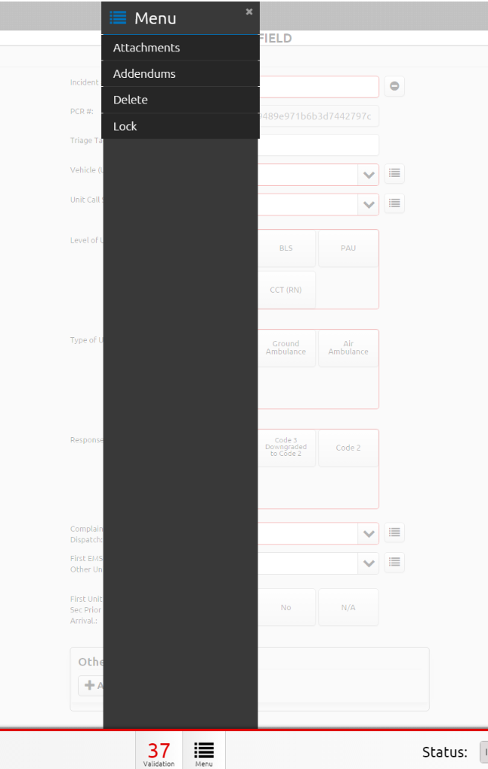
Attachments and Addendums option is available via the Menu option on the bottom of the screen

Slide 38
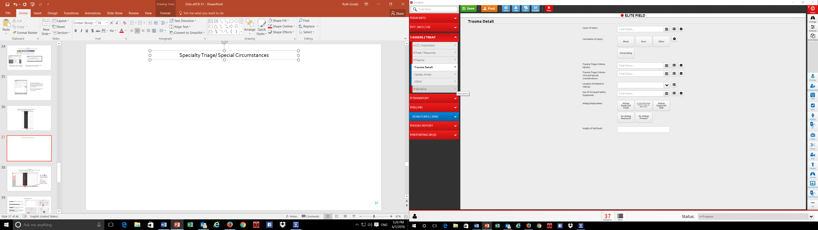
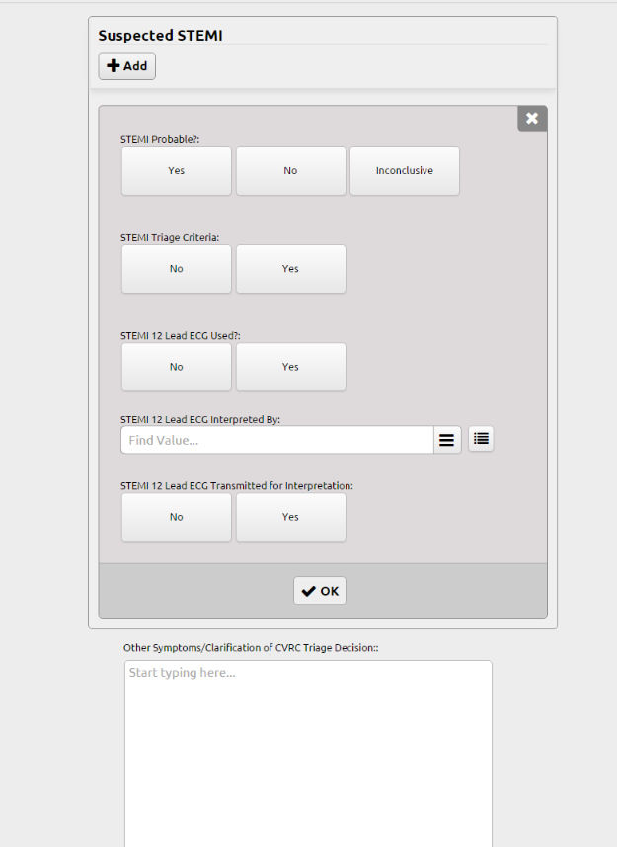
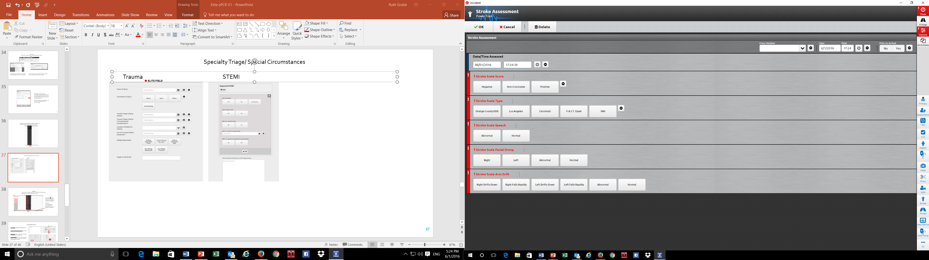
Specialty Triage/ Special Circumstances (Assess/Treat Section)
Trauma STEMI Stroke Power Tool

Slide 39
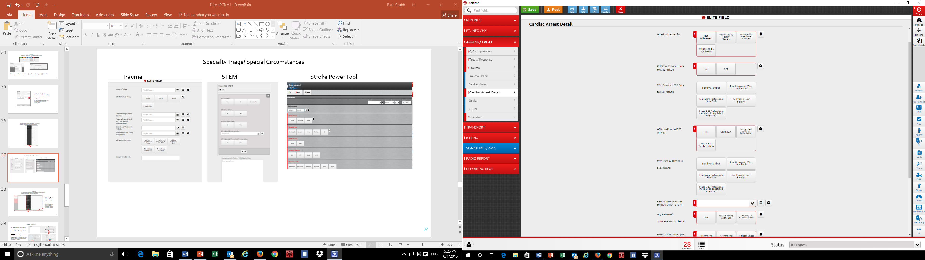

Cardiac Arrest Detail (Assess/Treat Section) IFT Report (Transport Section)

Slide 40




Clearing Data Fields
Text Fields: Highlight-Delete/Backspace
Drop Down Menus/Smart Lists: Click the X
Time Fields: Place curser in the Time field and click Clear on number pad
Select Buttons: (Present when drop down list has < 6 options): Click on the selected button again to unselect

Slide 41

Validation
A list of the incomplete data fields is available by clicking on the Validation box on the bottom of the screen
Click on the to the right of each message to open the field/Power Tool to be completed.
When the documentation has been completed, change the status of the call to Completed

Slide 42

The PDF
The PDF may be viewed by clicking on the Print icon
Post the incident when the documentation is complete.

Slide 43


Web Site: Incident List
To access posted incidents, click on the Incidents tab, then, View Existing EMS
Can create an incident from the Web site, by selecting Create New EMS-ePCR. Same functionality on Elite Field, just no need to post.

Slide 44

Unit notified time is the default filter. Modify or clear this date range to find all incidents posted.
Click on the Arrow to open the incident
View Attachments:
Create a system message (QA/QI) note:
See Incident History:
View PDF:

Slide 45


Customizing the Incident List Columns
To select additional/different columns to appear on the incident list, on the Incident List screen, click on More and Select Columns
Click on any of the listed data elements to add to the columns visible. Click and drag the selected data elements to change the order (from left to right)

