Slide 1
Best Practices
How do I do it Correctly…

Slide 2
While Moving Forward
How do I transition on the fly…While riding a bike don’t stop peddling

Slide 3
Keynote Presentations
IT
(Translating iOS from Windows perspective)
Brass
(Impact on People, Organization, Budget)
How To Pull this off
(CheckList)

Slide 4
Conclusions…
AppleID Strategy
MDM
App Deployment
Self Feed v. Force Feed
Don’t Manage AppleID’s; use and Alias Strategy for email accounts
The MDM will allow you to manipulate XML data and keys on the devices; you don’t image in the old way
You can force uses to depend on you or train them to pull apps themselves

Slide 5
Terms
MDM
Mobile Device Management
VPP
Volumne Purchase Program
DEP
Device Enrollment Program
$$$$
Usually a cost handled by IT, yearly subscription
Conflict
Purchasing and the department handling the MDM must work together well
Purchasing
Must provide you acess through Apple to your Serial numbers

Slide 6
Major Decsion…
Single User, Single Device
iPhone, iPad
Multiple User, Single Device
iPhone, iPad
Single User, Multiple Devices
iPhone, iPad
Classic Police Deployment
Check the device out to the user, they sign for it.
Classic Fire Deployment
Device is part of the engine or companion to other gear.
Administrative Deployment
User has a bigger issue getting to all their files from multiple devices
Notes:
This presentation that follows only give you the Classic Fire Department deployment.

Slide 7
Keynote Presentations
IT
(Translating iOS from Windows perspective)
Brass
(Impact on People, Organization, Budget)
How To Pull this off
(CheckList)
Notes:
The first thing you don’t do is use iTunes to manage lots of devices, and while Apple Configurator is a good start it also won’t work for in the long run. This section takes you through a checklist style of options you need to do to roll this out well.

Slide 8
Terms (CheckList)
MDM
Mobile Device Management
VPP
Volumne Purchase Program
DEP
Device Enrollment Program
Cost and IT
In order to scale support you must have and MDM.
Apple Configurator
This software does not scale to devices which leave your physical location, it only works over USB for maintenance.
Without an MDM your project will be dependant upon you physically touching devices all the time.
Notes:
You cannot grow or support more than 20 devices without and MDM server it is required for sanity.
You can buy these from many third parties Apple does not offer one that is a production server. They can be purchased as Cloud offerings or stand alone servers. The Cloud offerings are cheaper, easier to setup and offer all the security of the stand alone servers. You can find a list at www.enterpriseios.com.

Slide 9
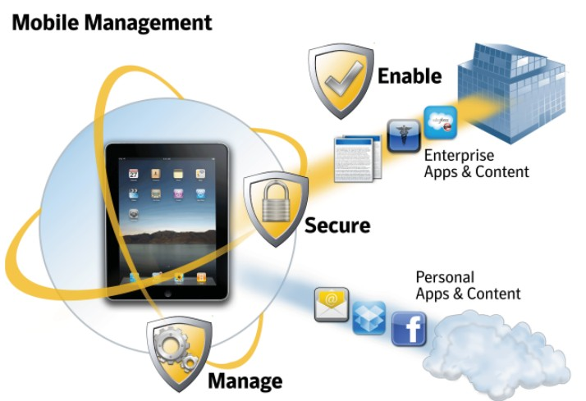
Mobile Device Management
Notes:
While some IT environments work well with a unmanaged approach, there are a number of examples where a Mobile Device Management (MDM) solution is more appropriate. iOS features Mobile Device Management capabilities that to can be integrated with third-party solutions to enable IT departments to wirelessly configure and update settings, monitor compliance with corporate policies, and even wipe or lock managed devices.
Let’s talk about what Mobile Device Management can do for your company.
• Picture of an iPhone and iPad in front of a rig then an arrow pointing to a cloud where MDM is located.

Slide 10
What does an MDM do…
Install and removes apps
Sets up the device for settings like VPN, Mail and websites.
Give you reports on the devices
Tracks what apps you have sent out
Remote wipe and lock
Lets you solve problems without physically touching the devices
Clear passcode
Notes:
When a device is managed, it can be administered by the mobile device management server through a set of specific actions.
Configuration and Provisioning Profiles
To configure devices and provision in-house applications, mobile device management servers can add and remove Configuration Profiles and Application Provisioning Profiles remotely.
Query devices
Query the device for a variety of attributes.
Manage apps
An MDM server can manage third-party apps from the App Store, as well as enterprise in-house applications. The server can remove managed apps and their associated data on demand or specify whether the apps are removed when the MDM profile is removed.
Remote lock
The server locks the iPhone and requires the device passcode to unlock it.
Remote wipe
A mobile device management server can remotely wipe an iPhone. This will permanently delete all media and data on the iPhone, restoring it to factory settings.
Clear passcode
This action temporarily removes the device passcode for users who have forgotten it. If the device has a policy requiring a passcode, the user will be required to create a new one.
Need a picture of a fireman in front of laptop making a change in another picture next to it a fireman remote to him getting that change on an iPad showing the concept of “remote”.

Slide 11
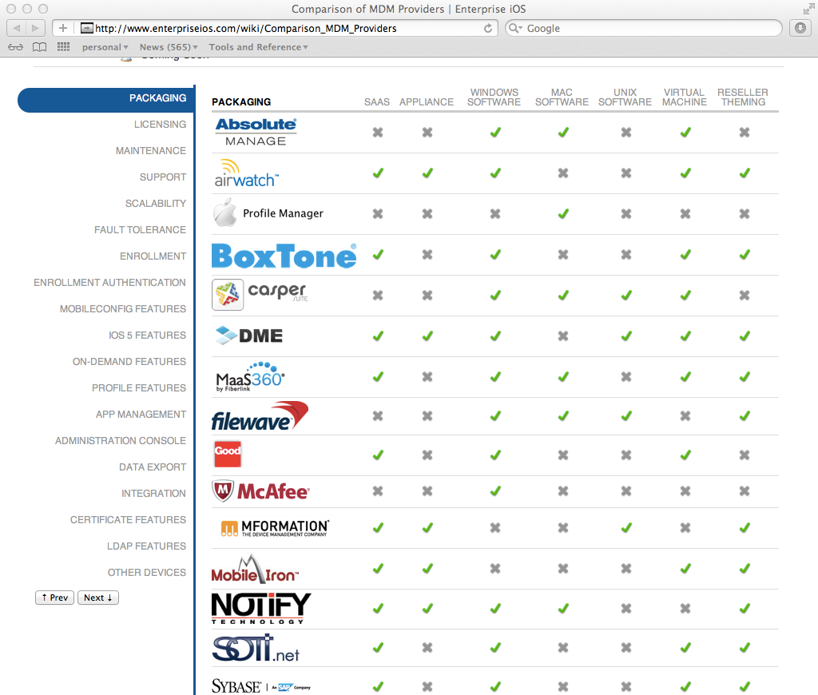
MDM Server
Usually IT Manages the MDM and Gives a log on to someone in FD
Pick a Vendor, Strategy, Process
enterpriseios.com
Cloud or On Premise
Notes:
You have to buy one of these for your department.

Slide 12
Terms (CheckList)
MDM
Mobile Device Management
VPP
Volumne Purchase Program
DEP
Device Enrollment Program
Sign Up for VPP (Free)
Only a specific use AppleID Login account should be used and for only this purpose.
Purchasing usually does this function.
You can have multiple sub accounts under one VPP account to handle department purchases.
You can purchase license codes or redemptions codes. License codes keep you in control of the software after it is issued.
Notes:
If you issue free apps this does not apply, if you buy apps you and want to deploy them you use the VPP program to purchase “redemption codes” with cannot be re-used or “License codes” which can be re-used to send apps out from you MDM server. Since this involves money purchasing is usually involved in getting the codes which come on a spreadsheet via email and are forwarded to the person working the MDM.

Slide 13
Terms (CheckList)
MDM
Mobile Device Management
VPP
Volumne Purchase Program
DEP
Device Enrollment Program
Sign Up for DEP (Free)
Only a specific use AppleID Login account should be used and for only this purpose.
Apple Configurator
Get your customer and vendor ID numbers from your vendor NOT Apple.
DEP requires that chain or ownership be established by your Vendor and Apple NO ONE ELSE matters.
Notes:
It is VITAL that the products be purchased from a reseller that registers the devices into the DEP program so you can manage them. You can NEVER put them in later, so a product for example purchased by the county or purchased at the Apple Store can NEVER be put into your DEP account. In the case of the County they will have to point that device to your MDM server or in the case of the Apple Store you can never have it put into DEP, be very careful how these devices are purchased.

Slide 14
AppleID
Assign them by Rig
One AppleID Per Rig, Devices on Rig use the same one
Dont’ give out the password, updates will be a pain
In iOS9 this will be less important
Notes:
come up with a naming sequence that makes sense like rig name/numberstationname/number/iPad job. You want them named for the rig they STAY ON if command staff has a unit it doesn’t get name to a RIG or a Station. If its a personal device it’s a personal AppleID.
Hint, each AppleID needs a unique email address. Have you IT department create ONE email account for all the iPads and then create alias that point to that one email account that are the same name that your are going to use above. All the emails will go to one account so you don’t have to have duplicates and no one can send a change password request to the email account and get the email since it will always go to the one email account they have setup. If you don’t do this your IT group will have to setup multiple email accounts and they won’t buy you cold drinks on Friday because you are creating lots of extra work for them.
If a device is registered in DEP and you put iOS 9 on the device you can send a paid for app to the device from your MDM and the AppleID won’t matter, this is cool and better so AppleID’s are important now but less in the future.

Slide 15
Get Started…
iOS 9 Deployment Technical Reference
iBooks - https://itunes.apple.com/us/book/ios-deployment-reference/id917468024?mt=11
Online - https://help.apple.com/deployment/ios/
iOS 8 Deployment Technical Reference
iBook - https://itunes.apple.com/us/book/ios-deployment-reference/id917468024?mt=11
Online - https://help.apple.com/deployment/ios
PDF - http://manuals.info.apple.com/MANUALS/1000/MA1685/en_US/ios_deployment_reference.pdf
Device Enrollment Program (DEP) Guide
PDF - http://images.apple.com/business/docs/DEP_Business_Guide.pdf
Online - https://help.apple.com/deployment/programs/
Volume Purchase Program (VPP) Guide
http://images.apple.com/business/docs/VPP_Business_Guide.pdf
Online - https://help.apple.com/deployment/programs/
iOS Security White Paper
http://www.apple.com/business/docs/iOS_Security_Guide.pdf

