Slide 1
Health Information Exchange for Emergency Medical Services HIE+EMS: An Introduction Where we are now…Where we are going …and what’s in it for me??? March 2018

Slide 2
Objectives
Introduction to OC’s Regional HIE.
Discuss benefits to EMS Providers.
Define Health Information Exchange for EMS and describe the “SAFR” model.
Describe what has already been done to connect existing systems together.
Discuss next steps and the plan for the near future.

Slide 3
What’s in it for me???
Search a patients medical record and download History, Allergies. Meds into your ePCR.
Alert Hospital when you have a STEMI, Stroke, or Trauma Patient through the system.
Share your PCR with ED physicians.
Obtain patient outcome information (ED diagnosis, ED disposition)
Transfer your PCRs in the field regardless of ePCR system used.
Third party ePCR systems can use the system too.

Slide 4
Who is our Regional HIE?
OCPRHIO
One California Partnership Regional Health Information Organization

Slide 5
OCPRHIO

Slide 6
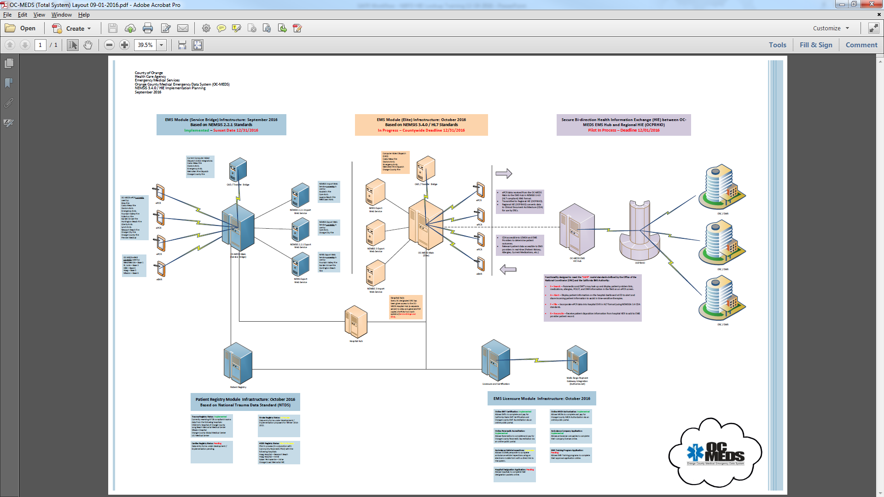

Slide 7
HIE+EMS
Health Information Exchange (HIE)
HIE is the secure exchange of health care data among health care providers, facilities, medical insurance providers, and government agencies.
HIE+EMS
Secure, bi-directional exchange of data between health care facilities and EMS providers using the federally defined “SAFR” model – Search – Alert – File – Reconcile.

Slide 9
HIE+EMS Project
2016 - OC and 2 other CA Counties awarded grant funds to implement / pilot HIE+EMS / SAFR.
Must have one facility and one 911 EMS transport provider.
Hoag Hospital – Newport Beach
Newport Beach Fire Department
2017 - Technical Development between OC-MEDS and OCPRHIO to implement “SAFR”.
And the results…

Slide 10
…OC 1st HIE+EMS project in the US to implement SAFR

Slide 11
Next Steps
Lessons Learned:
Improvements to how EMS providers view and use the HIE in their ePCR run forms are needed (and are underway).
Receiving Facility EDs must be made more aware of the HIE and how to view/use EMS data for clinical patient care.
Outcome data received must be configured to allow for aggregation (to make it easily reportable).
Add more EMS Providers:
Anaheim Fire Department
Huntington Beach Fire Department

Slide 12
More Funding on the Horizon
The system is currently supported by OCEMS.
There are strong prospects for more grant funds to seriously enhance the system going forward.

Slide 13
Questions???

