Slide 1
Orange County EMS
Bi-Directional Data Exchange Project
Final Report
Emergency Medical Care Committee (EMCC)
January 10, 2025

Slide 2
Project Scope
Ensure return of patient outcome data from ERCs to EMS providers and OCEMS in compliance with local policies.
Establish dashboards and analytics based on aggregated outcome data received from ERCs to improve patient care and countywide medical/health situational awareness.
Establish secure connections between OC-MEDS and each ERC Electronic Health Records (EHR) system to ensure near real time transmission of EMS PCRs for clinical use.

Slide 3



Data Flow
ADT / Discharge Data
Project Scope
ERC - EHR
EMS - ePCR
OC-MEDS

Slide 4
Timeline
Jan. 2022
Jun. 2024
Provider Engagement
Project Marketing
Contracts / Agreements
Project Management
Secure Connections
Workflow Development
End to End Testing
End User Training
Go Live Monitoring
Ongoing Management

Slide 5
Provider Participation
14
21
Anaheim Fire and Rescue
Brea Fire Department
Care / Falck Ambulance
Costa Mesa Fire and Rescue
Emergency Ambulance Service
Huntington Beach Fire Department
Fountain Valley Fire Department
Fullerton Fire Department
Laguna Beach Fire Department
Los Angeles County Fire Department
Lynch EMS
Newport Beach Fire Department
Orange City Fire Department
Premier Medical Transport
Children’s Hospital of Orange County
Hoag Hospital – Newport Beach
Hoag Hospital – Irvine
Providence - St. Jude Medical Center
Providence - St. Joseph Hospital
Providence – Mission Hospital Laguna Beach
Providence – Mission Hospital Mission Viejo
Kaiser Permanente – Anaheim
Kaiser Permanente – Irvine
KPC - Anaheim Global Medical Center
KPC – Orange County Global Medical Center
KPC – South Coast Global Medical Center
Prime Health – Huntington Beach Hospital
Prime Health – Garden Grove Hospital
Prime Health – La Palma Intercommunity Hospital
Prime Health – West Anaheim Medical Center
Prospect Medical – Foothill Regional Medical Center
UCI Health – Fountain Valley
UCI Health – Los Alamitos
UCI Health – Placentia Linda
UCI Medical Center

Slide 6

Success Rate
83%

Slide 7
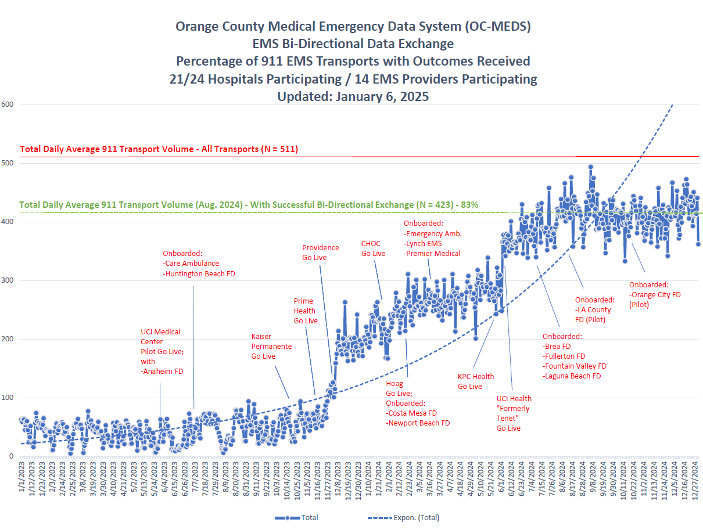
Progress Chart

Slide 8
Benefits for ERCs
EMS PCR automatically attached to patient chart
Meets OCEMS Hospital Discharge reporting requirement
Evidence based reports/analytics based on EMS patient outcomes

Slide 9
Benefits for EMS Providers
PCR immediately available to ER Staff in their EHR
Meets CEMSIS requirements for eOutcomes fields
Near real time Outcome data for CQI, Education, Cost recovery, etc.

Slide 10
Next Steps / Challenges
Onboard remaining hospitals and EMS Providers
Develop meaningful reports and dashboards for use by system participants.
Long Term Sustainability
Ongoing Management and Maintenance
Change Management
Ongoing Training

Slide 11

Project Website
www.ochealthinfo.com/ems/OC-MEDS/HIH

Slide 12


One more thing…
https://www.counties.org/post/2024-challenge-awards

Slide 13

Questions???
Use for global change of fonts
  To access, click “view, master, slide master”
  Title, body, footer
Use to change bullets
  Color and/or size

