Slide 1
2025 Statewide Medical & Health Exercise
Water Disruption
Functional Exercise
April 24, 2025

Slide 2

Welcome and Overview
Welcome
Name
Position
Agency/Organization
Optional: Icebreaker
Materials
Situation Manual
Feedback Form
Player Handout

Slide 3
Statewide Medical and Health Exercise Overview
The Statewide Medical Health Exercise (SWMHE) is an annual event designed to enhance the preparedness and response capabilities of the healthcare system.
The purpose of this exercise is to provide participants with an opportunity to evaluate current response concepts, plans, and capabilities in response to the scenario.

Slide 4
Exercise Goals
Exercise Goals
Test and validate policies, plans, procedures, training, equipment, and agreements
Clarify and train personnel in roles and responsibilities in emergency response and recovery
Improve interagency coordination
Identify gaps in resources and response plans
Strengthen relationships among all participating agencies
Meet various requirements from regulatory and accreditation agencies

Slide 5
Exercise Schedule
Time | Activity
7:30 AM | Controller and Evaluator/Mentor Briefing Site Set Up
8:00 AM | Player Arrival and Sign In
8:15 AM | Player Briefing
8:45 AM | Players in Position, Communications Check
9:00 AM | Start Exercise
12:00 PM | End Exercise
12:15 PM | Exercise Hotwash
12:45 PM | Controller/Evaluator Debriefing
1:15 PM | Venue Cleanup and Adjourn

Slide 6
Exercise Overview
Exercise Name | 2025 Orange County SWMHE Full Scale Exercise (FSE)
Exercise Dates | April 24, 2025
Scope | This FSE is planned for the Orange County Health Care Agency – Emergency Medical Services, healthcare coalition partners, healthcare facilities and organizations, and emergency response partners as part of the Statewide Medical and Health Exercise. This FSE will take place on April 24, 2025 from 9:00 AM to 12:00 PM at the [Insert Location].
PHEP Capabilities | Emergency Operations Coordination; Information Sharing; Emergency Public Information and Warning; Medical Surge.
HPP Capabilities | Health Care and Medical Response Coordination; Continuity of Health Care Service Delivery; Medical Surge.

Slide 7
Exercise Overview
Objectives | [Each organization should select their appropriate objectives from the list in the Exercise Plan and add anymore custom objectives applicable.]

Slide 8
Exercise Documents
  Exercise Plan (ExPlan)- This ExPlan provides exercise participants with all the necessary tools and information to perform their roles in the exercise.
  Master Sequence of Events List (MSEL) - Provides a chronological timeline of actions and events that will occur during the exercise. (Internal document)
  Exercise Evaluation Guide – Provides a framework for to analyze the effectiveness and success of an exercise. (Only for those who are evaluating the exercise)

Slide 9
Participants Roles and Responsibilities
Exercise Participants/Players: Engage actively in the exercise by responding to the scenario and exercise injects. Lead your organizations exercise and engage staff.
Simulation Cell (SimCell): The SimCell plays a crucial role in creating realistic scenarios and responses during a functional exercise. This team is responsible for managing injects, which are simulated events or scenarios that drive the exercise forward. The SimCell will be played by County EMS.
Evaluators: Assesses the effectiveness of the exercise, identifies strengths and areas for improvement.
Controllers (if applicable): Control delivery of injects to exercise players.
Observers: Monitor the exercise process, noting any deviations or issues that arise.

Slide 10
Simulation Cell (SimCell)
The SimCell enhances exercise realism by simulating the functions of those organizations unable to participate in the exercise
Simulators deliver messages based on the planned scenario and the MSEL
Simulators may be required to ad lib messages
SimCell Controller supervises the overall conduct of the exercise, ensuring it proceeds as planned and objectives are reached

Slide 11




Simulation Cell (SimCell)
Players call the SimCell if they want to reach an “Agency” that is NOT participating in the exercise
SimCell
Participating Agencies are
listed on the Communications Directory
Player
Notes:
Lee to present

Slide 12
Exercise Guidelines
This is an open, low-stress, no-fault environment.
The exercise is primarily designed to support and enhance recent training. Participants are not being evaluated.
Participate based on your knowledge of capabilities, and any insights derived from training (i.e., you may use only existing assets). Use the resource guide for available resources.
The goal is to practice the skills you learned at the EOC Academy so you can better support your EOC in event of an activation.

Slide 13
Assumptions and Artificialities
Assumptions
  The exercise is conducted in a no-fault learning environment wherein players will have a chance to test capabilities, plans, systems, and processes
  The exercise scenario is plausible, and events occur as they are presented
Artificialities
  Impacts across the operational area
  Some time lapses may be artificially used to achieve the exercise objectives

Slide 14

Exercise Evaluation
Exercise Evaluation
  Participant Feedback Forms – Scan QR Code or complete a hard copy.
  Hot Wash Notes –Immediately following the exercise, we will conduct a short discussion on strengths and areas for improvement.

Slide 15
Considerations When Responding to the Scenario
Will there be enough:
  Staff?
  Space?
  Supplies & Equipment?
Special considerations:
  Evacuations
  Staffing Impacts
  Available Water Resources
  Responder Safety
  Public Messaging
  System? (i.e., patient tracking, messaging)

Slide 16
Exercise Rules
The following general rules govern exercise play:
Real-world emergency actions take priority over exercise actions.
Exercise players will comply with real-world emergency procedures, unless otherwise directed by the control staff.
All communications (including written, radio, telephone, and e-mail) during the exercise will begin and end with the statement “This is an exercise.”
Exercise players who place telephone calls or initiate radio communication with the SimCell or through ReddiNet must identify the organization or individual with whom they wish to speak.
  Only use contact information found in the Exercise Plan Communications Plan (Appendix C)

Slide 17
Start Exercise

Slide 18

Scenario
Water Contamination due to Criminal Activity
Officials have identified suspicious activities around key water infrastructure sites in Orange County.
An anonymous social media account has posted cryptic messages alluding to an attack on public utilities, heightening concerns of an orchestrated effort.
Over the past 72 hours, emergency departments across Orange County have seen a surge in patients.
The scope of the contamination is under investigation.
The Health Officer is currently considering implementing a Countywide “do not use” order.
Don’t Fight the Scenario!

Slide 19
Scenario (Continued)
The County Health Officer has implemented a “do not use” order for the entire county.
It is unclear how long this advisory will be in place.
The Water Emergency Response Organization is working with all potable water districts to assess the impacts of each region. The current severity of the impact is unknow.
The County EMS AOC has been fully activated to support.

Slide 20
End Exercise

Slide 21
Hotwash

Slide 22
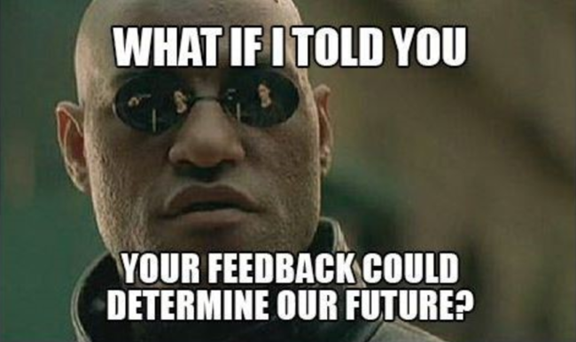
Exercise Hot Wash
  Provide two strengths that you observed during today’s discussion
  Provide two areas for improvements that you observed during today’s discussion.

Slide 23
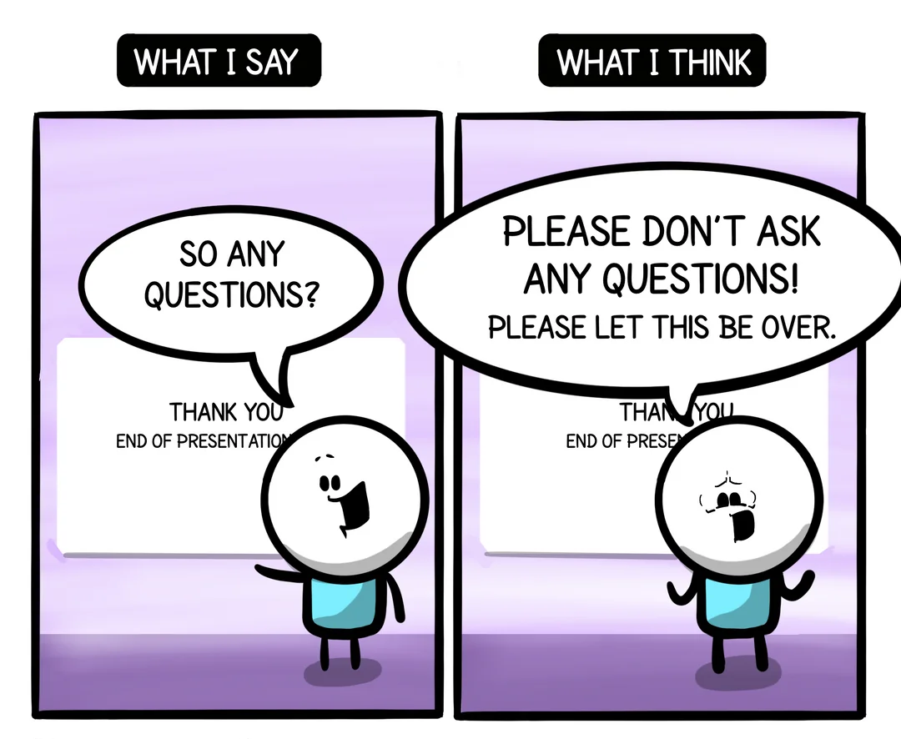
Questions?

Slide 24

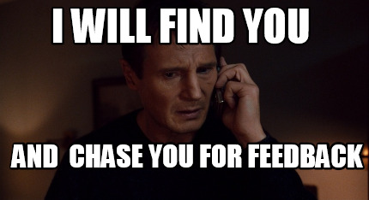
Participant Feedback Forms
Exercise Evaluation
  Participant Feedback Forms: Scan the QR Code or complete a hard copy of the evaluation.

Slide 25
Thank You!

