Slide 1



Lanterman Petris Short (LPS) Designated Provider
SB 43 Discussion Meeting February 24, 2025
Linda Molina, LCSW
Rebekah Radomski, LMFT
Mark Lawrenz, LCSW
Glenda Aguilar, LMFT
BHS
Behavioral Health Services

Slide 2

Agenda
Welcome and Introductions
Readiness Survey
Review of Regulation Changes
Break
Planning Updates
SUD System of Care
Q & A

Slide 3

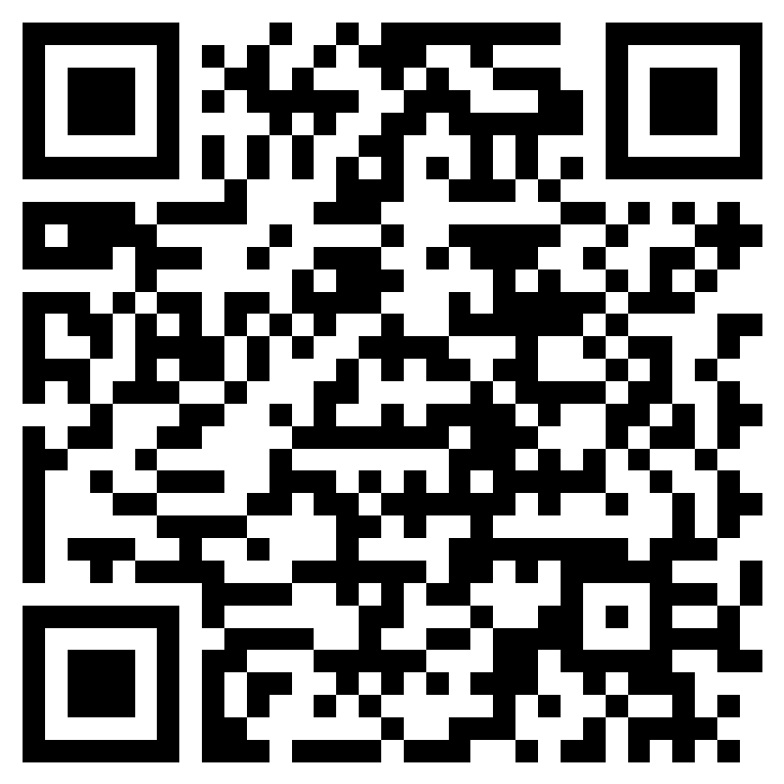
Readiness Survey Part 1

Slide 4
Most significant reform to the LPS Act since it was enacted in 1967.
Significantly expands California’s criteria for involuntary detention and conservatorship by creating a new set of eligibility criteria that are based solely on a person’s mental health disorder or “severe” substance use disorder (SUD), if that disorder will result in someone being unable to provide for their basic needs of food, clothing, shelter, personal safety or necessary medical care.
Impacts adult population only
Signed into law Oct 2023 but allows counties to delay implementation of the new grave disability criteria until 1/1/26 through adoption of a county board resolution. On 12/5/23 the BOS of Orange County voted to approve said resolution with a 4-1 vote.
Overview of Senate Bill (SB) 43

Slide 5
Portions of SB 43 effective 1/1/24:
Allows health records to be used as evidence in LPS conservatorship proceedings, ensuring individuals can be conserved without requiring testimony from their treating team.
Requires counties to consider less restrictive alternatives such as assisted outpatient treatment (AOT) and CARE Court in conducting conservatorship investigations; and all other less restrictive alternatives.
New reporting requirements effective 5/1/24:
# placed on holds or conservatorships due to:
  Danger to self
  Danger to others
  GD due to MH
  GD due to SUD
  GD due to Co-occurring MH SUD
Overview of Senate Bill (SB) 43

Slide 6
Revised Definition of Grave Disability
  Current grave disability definition: A condition in which a person, as a result of a mental health disorder, is unable to provide for his or her basic personal needs for food, clothing, or shelter.
  *NEW* grave disability definition under SB 43: A condition in which a person, as result of a mental health disorder, severe substance use disorder* or a co-occurring mental health disorder and severe substance use disorder, is at risk for serious harm or currently experiencing serious harm as a result of being unable to provide for their basic needs of food, clothing, shelter, personal safety* or necessary medical care*.
  *New/expanded criteria to meet grave disability under SB 43

Slide 7

Definition of Severe Substance Use Disorder
DSM-5 TR Criteria
for SUDs
Taking the substance in larger amounts or for longer than you're meant to
Wanting to cut down or stop using the substance but not managing to
Spending a lot of time getting, using, or recovering from use of the substance
Cravings and urges to use the substance
Not managing to do what you should at work, home, or school because of substance use
Continuing to use, even when it causes problems in relationships
Giving up important social, occupational, or recreational activities because of substance use
Using substances again and again, even when it puts you in danger
Continuing to use, even when you know you have a physical or psychological problem that could have been caused or made worse by the substance
Needing more of the substance to get the effect you want (tolerance)
Development of withdrawal symptoms, which can be relieved by taking more of the substance
Mild:
2-3 symptoms
Moderate:
4-5 symptoms
Severe:
6+ symptoms

Slide 8
Definition of Severe Substance Use Disorder
“Severe” SUD is defined as a diagnosed substance-related disorder that meets the diagnostic criteria of “severe” according to the most current version of Diagnostic and Statistical Manual of Mental Disorders (DSM-5) at the time of the evaluation for involuntary detention.
Importantly, non-clinicians who are LPS designated to place holds (e.g., law enforcement) are not expected to make a DSM diagnosis for a SUD but simply need to describe the observable behavior or conditions that justify a 5150 being placed due to a severe SUD, which should include and be consistent with the DSM criteria noted above and which would meet probable cause for detaining someone due to a severe SUD.

Slide 9

Definition of Necessary Medical Care
“Necessary medical care” means care that a licensed health care practitioner, while operating within the scope of their practice, determines to be necessary to prevent serious deterioration of an existing physical medical condition which, if left untreated, is likely to result in serious bodily injury as defined in W&I Code § 15610.67.

Slide 10
Indications of Grave Disability:
Necessary Medical Care
The following are examples; not an exhaustive list. These observable functioning impairments must be resulting in a serious deterioration of an existing physical medical condition which, if left untreated, is likely to result in serious bodily injury or the person’s inability to survive safely in the community without involuntary detention or treatment.
Necessary Medical Care – due to mental health and/or severe substance use disorder:
Signs of significant malnourishment (loss of weight or dehydration) which puts the individual’s life or long-term functioning at risk.
Perceived cognitive and/or emotional impairment resulting in a lack of decision-making capacity to pursue medical treatment for life-threatening conditions in the moment including but not limited to: Inability to utilize medical care when needed and available.
Wound care and infection issues that are likely to lead to loss of limb or life if not treated.

Slide 11

Definition of Personal Safety
“Personal safety” means the ability of one to survive safely in the community without involuntary detention or treatment pursuant to [the LPS Act].
“Personal safety” means the ability of one to survive safely in the community without involuntary detention or treatment pursuant to [the LPS Act].

Slide 12
Indications of Grave Disability:
Personal Safety
The following are examples; not an exhaustive list. One incident alone would not automatically meet the standard to detain a person. These examples must be significant and severe enough to cause serious bodily injury or death and must be related to a severe mental illness or severe SUDs but not some form of dementia.
Placing oneself in harm’s way in traffic that risk their own life or those of others.
An individual incapable of defending themselves against ongoing victimization due to a lack of awareness of their vulnerability.
Severe impaired judgement resulting in risky situations that threaten the person’s own life or those of others.
Unhygienic/uninhabitable living conditions or behaviors which are so severe and significant to contribute to an unsafe physical environment. Poor hygiene alone and/or being unhoused is not sufficient.
Repeated severe substance use that is medically life-threatening, for example, multiple near-fatal overdoses requiring medical intervention.

Slide 13
Identifying Grave Disability for Involuntary Holds
The two main legal criteria that MUST be connected to show "cause" and "effect”:
Cause (the diagnosis): Mental Health Disorder OR Severe Substance Use Disorder OR Mental Health + Substance Use Disorder.
Effect: Inability to provide for food, clothing, shelter, personal safety OR necessary medical care.
EFFECT
To show Grave Disability, specific facts must show that the symptoms of the cause / diagnosis are causing the inability to provide.
CAUSE
EFFECT
EFFECT

Slide 14
Overview of
SB 1238
Signed by the Governor September 2024
Companion bill to help implement SB 43
Expands the types of facilities DHCS can designate
Requires DHCS to issue guidance regarding Medi-Cal reimbursement for covered Medi-Cal services provided to an individual receiving involuntary treatment for a severe substance use disorder
Requires DHCS to convene stakeholder representatives to establish updated regulations to develop LPS designation requirements for facilities serving the expanded population
Establishes minimum requirements for these regulations
Notes:
“The guidance shall be consistent with Medi-Cal reimbursement for covered Medi-Cal services provided to an individual receiving involuntary treatment for a mental health disorder pursuant to this part, to the extent that federal financial participation under the Medi-Cal program is not jeopardized and all necessary federal approvals have been obtained. The state may implement, interpret or make specific this section in whole or in part, by means of plan or county letters, information notices, plan or provider bulletins or other similar instructions w/o taking further regulatory action.”

Slide 15
SB 1238:
List of Expanded Designated Facility Types
Psychiatric health facilities licensed by the State Department of Health Care Services (DHCS).
Psychiatric residential treatment facilities licensed by DHCS.
Mental health rehabilitation centers licensed by DHCS.
Provider sites certified by DHCS or a Mental Health Plan to provide crisis stabilization.
General acute care hospitals licensed by the State Department of Public Health (CDPH).
Acute psychiatric hospitals licensed by CDPH.
Chemical dependency recovery hospitals licensed by the CDPH.
Hospitals operated by the United States Department of Veterans Affairs.
Notes:
The sites in OC that are currently capable per DHCS guidance to receive individuals on involuntary detention under the expanded definition are underlined.

Slide 16
Minimum substance use disorder related service requirements with sufficient substance use disorder staff to maintain appropriate substance use disorder only and cooccurring disorder programs, treatment setting, services, and safety measures, based on the individual patient’s substance use disorder needs.
Standards for offering medications for addiction treatment (MAT) or an effective referral process in place with narcotic treatment programs, community health centers, or other MAT providers.
Length of stay standards consistent with evidence-based care for substance use disorders.
Discharge planning for substance use disorder services, consistent with existing requirements.
SB 1238: Minimum Requirements for SUD

Slide 17
Privacy and data sharing requirements, including, but not limited to developing guidance and tools to facilitate data sharing for care coordination and discharge purposes.
The process for transitioning and assisting designated facilities to meet updated regulatory requirements, including, but not limited to, providing substance use disorder services.
Systems of public accountability and oversight that include, but are not limited to, readiness to meet, and ongoing maintenance of, required standards for staffing, facilities, and care established pursuant to this section.
SB 1238: Minimum Requirements for SUD
Notes:
DHCS may implement interpret or make specific this section by means of plan or county letters, info notices, plan or provider bulletins, or other similar instructions, until the time regulations are adopted no later than 12/31/27

Slide 18
Questions?

Slide 19
Intermission

Slide 20
Planning Updates
    HCA Needs Assessment Survey completed in 2024
    Invited input from Hospitals, Law Enforcement Agencies and the Public Guardian
    Surveyed Resource Capacity and Concerns
Notes:
HCA started our planning efforts last year and kicked it off with a Needs Assessment Survey.
Invited input from 34 Hospitals, 26 Law Enforcement Agencies and the Public Guardian; 6 hospitals and 5 law enforcement agencies responded
Surveyed bed capacity for severe SUD, policies to treat expanded population, ability to increase bed capacity and staffing, provision or interest in providing MAT
Concerns noted included:
lack of current capacity for 5150s
no space to expand bed capacity
lack of training/expertise in SUD
lack of MAT and/or physicians to initiate/continue MAT
staffing
costs related to increased length of stay / uninsured or out of county patients
lack of policies to work with expanded population
lack of equipment and medical personnel to treat comorbidities
Lack of LTC facilities to treat SUD or comorbidities
Lack of evidence that coerced SUD treatment is effective
We share the concerns - This is an unfunded mandate for ALL of us – counties, hospitals, PG, law enforcement, courts…
We need to come together as a community to find and create solutions – which is why we are here today
We want to share our planning efforts with you and engage discussion on our challenges, needs and solutions

Slide 21
Statewide Planning
  Statewide workgroup developing guidelines and tools for implementing SB 43
  Input sought from California Hospital Association (CHA) and the California Association of Public Administrators, Public Guardians, and Public Conservators (PA/PG/PC)
  Established proposed guidelines for defining Severe Substance Use Disorder, Medical and Personal Safety criteria
  Feedback from early adopters
Notes:
Two counties implemented 2024; five more to start in 2025
San Francisco and San Luis Obispo started in 2023; Sacramento, San Diego, San Bernadino, and Stanislaus Counties implementing in 2025
Consistent feedback from those who’ve gone live is the vast majority of the individuals being placed on holds under the expanded definitions are co-occurring – meaning folks we are already serving

Slide 22
OC SB 43 Planning
BHS Planning Meeting Focus:
  Community Education and Collaboration
  Training
  Treatment Continuum
  Staffing and Budget
Notes:
BHS Planning Workgroup includes members from Substance Use Disorder, Crisis and Acute Care, Adult and Older Adult, Quality Management, Contract Administration, Public Guardian, and EMS.
This list is not an exhaustive list but our primary focus to date has fallen into these 4 areas.

Slide 23
Presentations/Updates provided to:
    OC Sheriff Dept
    OC Chief of Police and Sheriffs Association
    Hospital Association of Southern CA (HASC)
    Behavioral Health Advisory Board (BHAB)
    Orange County Public Guardians Office (OCPG)
    Crisis Intervention Team Steering Committee (CIT)
    Designated Facilities Meeting
    Contract Hospital Provider Meeting
    OC Judges
OC SB 43 Community Education and Collaboration
Notes:
Crisis Intervention Team Steering Committee (CIT) attendees include OC Sheriff and multiple municipal law enforcement agencies, NAMI, hospitals, Behavioral Health Advisory Board representatives, family members, advocates and community-based organizations.

Slide 24
LPS Designation Training
  LPS Designation Training Revision
  Training County and Contract Provider LPS staff
  Training Designated Facility LPS Trainers
  New 5150 form
SUD Training
  County and Contract Provider staff
OC SB 43 Training
Notes:
LPS Designation Training materials have been revised to address the expanded grave disability definition
Training of all LPS staff has begun and will be on-going
Revising the LPS Designated Trainer materials is in process
The new 5150 form is ready and will be put into use January 2026
Given what appears will be more specifically defined minimum services for the expanded population, we are embarking on enhanced training for county operated and county contracted sites that will initiate or receive such holds. Glenda will discuss the availability of such training for Designated Facilities later today.

Slide 25
OC SB 43 Treatment Continuum
Treatment Continuum
  Initial Receiving Sites for the Expanded Population
  Treatment Sites
  Placement Sites
Staffing and Budget
Notes:
As stated, early adopters have advised the vast majority of the individuals detained have been had co-occurring mental health and severe SUD disorders and have been treated in the existing continuum of care. The initial receiving sites for individuals on involuntary detentions for the expanded population will be the same as they are now – CSUs and EDs. From there, based on the assessments of licensed health professionals, individuals will move to the next level of care. It is anticipated that Designated Facilities can expect to see an increase of referrals of such individuals.
HCA BHS is exploring the other possible expanded facility types to expand our capacity but know this comes at a time when BHS funding has been restructured by Prop 1/BHSA and the total funds available have been reduced – AND recent state projections regarding realignment funds will have a further negative impact. Additional rounds of state BHCIP grant funds for building or expanding facilities will come soon and may be a possible solution. But these funds cover facility costs not services.
This aspect of the SB 43 implementation process is very much a “building the plane while we are flying it” situation. No county had an existing continuum of care for involuntary SUD treatment. It didn’t exist. And the intention behind this regulation is not to create it. Through multiple different state initiatives and conversations with advocacy organizations it is clear the state is looking to move the system towards a more quality focused and integrated SUD/MH system of care as opposed to a standalone SUD LPS continuum.

Slide 26
Orange County’s Drug Medi-Cal
Continuum of Care
The Level of Care is determined by the American Society of Addiction Medicine (ASAM), the most widely used and comprehensive set of guidelines for placement, continued stay, and transfer/discharge of clients with SUD and/or co-occurring conditions
The HCA serves adult and adolescent Medi-Cal beneficiaries through the Drug Medi-Cal Organized Delivery System
Assessment is a continual process, and clients are transitioned into higher and lower levels of care depending on assessed medical necessity

Slide 27
Orange County’s Drug Medi-Cal
Continuum of Care
The Drug Medi-Cal Continuum of Care includes:
  Outpatient Treatment
  Medications for Addiction Treatment (MAT)
  Narcotic Treatment Programs (NTP)
  Withdrawal Management
  Residential Treatment
  Recovery Services and Supports

Slide 28
Includes two levels of care, including Outpatient Drug Free (up to 9 hours of treatment) and increased service delivery in Intensive Outpatient Treatment (9.5 hours plus)
Services Include:
    Assessment and Evaluation
    Treatment Planning
    Individual and Group Counseling
    Care Coordination
    Substance Use Education
    Drug Screening
    Referral and Linkage to Services
  12 Outpatient Clinics serving adults located in 12 cities
Outpatient Treatment

Slide 29
Medications for Addiction Treatment
Medications for Addiction Treatment also known as Medication Assisted Treatment (MAT) is the use of prescription medications for Opioid Use Disorder and Alcohol Use Disorder
There are several FDA approved medications, most are taken orally, and some are administered by injection
These medications are a vital part of treatment and may be used throughout a person’s recovery journey
These medications are especially effective in combination with counseling and behavioral therapies.
Access to these medication services are made available in all of SUD levels of care, and some treatment programs provide these medications directly

Slide 30
Narcotic Treatment Programs
Narcotic Treatment Programs (NTP), also known as Opioid Treatment Program (OTP). Services are available seven (7) days a week and are provided by licensed NTP facilities
Services Include:
    Assessment and Evaluation
    Medication for Substance Use Disorder, including methadone
    Individual and Group Counseling
    Care Coordination
    Substance Use Educational Groups
    Referral and Linkage to Services
    Coordination of dosing needs to client in residential and withdrawal management programs
Clinics locations in 5 cities
“Personal safety” means the ability of one to survive safely in the community without involuntary detention or treatment pursuant to [the LPS Act].

Slide 31
Withdrawal Management
Clinically supervised withdrawal management programs serve individuals 12 years and older who experience moderate withdrawal symptoms and need 24-hour support to safely withdraw from substances. Average length of stay is 4 to 5 days.
Services include:
  Assessment and Evaluation
  Observation
  Medication services
  Linkage to continuing care
9 Residential Facilities in 8 cities with a 94-bed capacity

Slide 32

Residential Treatment is a 24-hour, non-medical, short-term residential program that provides rehabilitation services when determined as medically necessary. Residential services require prior authorization by the County Plan. Average Length of stay is 45 days.
Services Include:
  Assessment and Evaluation
  Treatment Planning
  Individual and Group Counseling
  Substance Use Education
  Care Coordination
  Structured Activities
9 Residential Facilities in 8 cities with a 246-bed capacity
Residential Treatment

Slide 33
Recovery Services and Supports
Recovery Services include on-going recovery and wellness supports, such as support groups, that continue after treatment ends to support individual’s recovery journeys.
Recovery Residence housing is offered to adults 18 years and older that need a sober living environment. All residents must be enrolled and actively participating in a recovery service to maintain their sobriety. Housing is available up to 4 months.
Recovery Residence homes are currently available in 5 cities

Slide 34

How a person can access SUD services:
Beneficiary Access Line available 24/7, 365 days at 800-723-8641
OC Links available 24/7, 365 days at 855-625-4657
Walk-ins at any County-operated Mental Health and SUD outpatient clinics, including Open Access locations
Clients can contact contract providers directly to schedule an intake an appointment
Navigation Services and Supports

Slide 35
Authorization for Residential Treatment (ART)
Referrals for residential treatment for adults go through the Authorization for Residential Treatment (ART) Team. The ART Team provides a brief level of care assessment and authorizes and places adults into residential treatment.
To schedule an appointment, individuals may contact the Beneficiary Access Line at 800-723-8641 or can contact the Westminster ART Team directly at 714-934-4600.
Priority populations for admission into treatment, include:
      Pregnant Women
      Individuals who use IV Drugs
      Individuals with a Fentanyl Use Disorder
      Individuals receiving Withdrawal Management Services

Slide 36
Expansion of SUD Services Anticipated in 2025
Mobile Narcotic Treatment Program Services
BeWell Orange Campus:
  Reopening of Sobering Center
BeWell Irvine Campus:
  Sobering Center
  Adult Residential Treatment Program
  Perinatal Residential Treatment Program
  Adolescent Male Residential Treatment Program
  Adolescent Female Residential Treatment Program
System Wide Expansions
  Residential Treatment Bed Capacity
  MAT Services and Recovery Incentives
  Certified Peers

Slide 37
SUD Training Resources
Hazelden Training Program
  The Impacted Brain: Substances, Mental Health, and Recovery
  Pharmacotherapy for Opioid and Alcohol Use Disorders
  Trauma Informed Care Training
  CBT: Cognitive Behavioral Therapy
  Motivational Interviewing Beyond the Basics
  Medications for SUD Training (online)
  MOUD & After-hours calls (online)
  Naloxone Training (online)
MAT Training/CME Opportunities
  Providers Clinical Support System (PCSS) Medications for Opioid Use Disorder (MOUD) - PCSS-MOUD
    8-hour MOUD Training
  UCLA Opioid and Stimulant Implementation Support Training and Technical Assistance (OASIS-TTA) Opioid and Stimulant Implementation Support - Training and Technical Assistance (OASIS-TTA)
    On-Demand Learning Opportunities Catalog
  Opioid Response Network Events - Opioid Response Network
  American Society of Addiction Medicine (ASAM) ASAM eLearning: Home
  American Academy of Addiction Psychiatry (AAAP) Upcoming Webinars - AAAP

Slide 38
Questions?

Slide 39
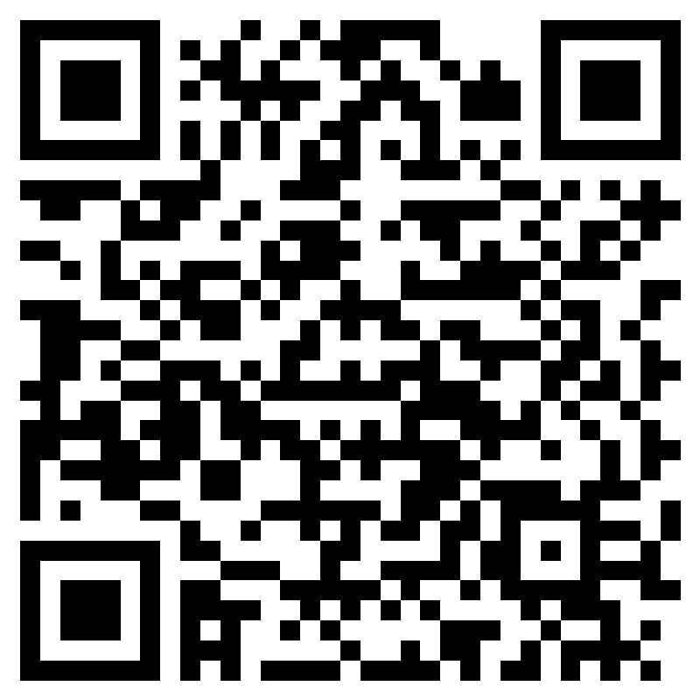
Readiness Survey Part 2

Slide 40
    Crisis and Acute Care
        Linda Molina, Assistant Deputy Director, (714) 834-2623
Quality Management Services
        Rebekah Radomski, Health Services Manager, (714) 834-5601
    Substance Use Disorder Services
        Mark Lawrenz , Assistant Deputy Director, (714) 834-3840
        Glenda Aguilar, Senior Health Services Manager, (714) 834-3840
Contact Info

Slide 41




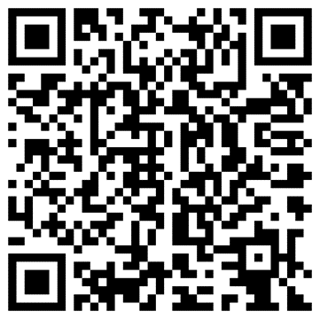


Thank you!
OC Health Care Agency
@ochealthinfo
www.ochealthinfo.com
@ochealth
@oc_hca
@ochealth

