Slide 1
Orange County Healthcare Coalition (OCHCC)
OCEMS/ Health Disaster Preparedness (HDP)

Slide 2
Our Advisory Committee:
General Chair: Teri Dart UCI-FV/ Co-Chair Keith Bohn WAMC/ LPMC
Hospital Advisory: Christopher Riccardi/ John Case
EMS Advisory: Tim Zimprich Falck / Andrew Tran (OCFA)
SNF/ LTC: *Caroline Crowell Park Anaheim Health Center
Dialysis: Danilo Concepcion St. Joseph’s (Dialysis Services)
Clinic/ Urgent Care/ Ambulatory Surgical Center: Ryan Yamamoto COO
Home Health/ Hospice: Aarti Sharma, Nitin Verma
County Introductions:
AFN Coordinator/ at Risk Populations: TBD

Slide 3
CAC Agenda:
Discussion: No Meeting for the Advisory Council took place, SWMHE26 took precedent
FIFA Planning
OCHCC Update(s):
On-going Discussions: Resource MGT Plan, Pt. Movement Plan
  Future grant funding
  General Session Topics
Budget Items Discussion:

Slide 4
Topics:
FIFA Planning
  FIFA planning activities
  Trainings: DVE recognition, Human Trafficking, CBRN topics
Looking to host a few topics to be our planning activities, even host a few HDMT courses to increase our preparedness in the county.
See additional PowerPoint for information regarding FIFA planning

Slide 5
Topic 2: Continue fiscal discussions/ Grant future
OCHCC Update(s):
On-going Discussions: Resource MGT Plan, Pt. Movement Plan
  Future grant funding
  General Session Topics
Budget Items Discussion:

Slide 6
Topic 3: Sector Chair nominations and voting
Caroline Crowell has nominated herself for the SNF/LTC Sector Chair

Slide 7
Topic 4:
OCHDMT As part of our FIFA Planning, we maybe hosting another HDMT.

Slide 8


Orange County Healthcare Coalition (OCHCC)
OCEMS/ Health Disaster Preparedness (HDP)

Slide 9


Agenda items:
Our Web-site:
https://www.ochealthinfo.com/ Click for providers and partners
Once on the page click Scroll down and look for
Once on this page, this is the main navigation page for your OCHCC resources.
Notes:
Bylaws will be found using this link.

Slide 10
Sector Chair Introductions:
General Chair: Teri Dart UCI-FV/ Co-Chair Keith Bohn WAMC/ LPMC
Hospital Advisory: Christopher Riccardi/ John Case
EMS Advisory: Tim Zimprich Falck / Andrew Tran (OCFA)
SNF/ LTC: *Caroline Crowell Park Anaheim Health Center
Dialysis: Danilo Concepcion St. Joseph’s (Dialysis Services)
Clinic/ Urgent Care/ Ambulatory Surgical Center: Ryan Yamamoto COO
Home Health/ Hospice: Aarti Sharma, Nitin Verma
County Introductions:
AFN Coordinator/ at Risk Populations: TBD

Slide 11
Sector Chair Updates:
Quarterly information sharing
General Chair: NR
Hospital Advisory: EMS Advisory: SNF/ LTC: Dialysis: NR
Clinic/ Urgent Care/ Ambulatory Surgical Center: NR
Home Health/ Hospice: NR

Slide 12
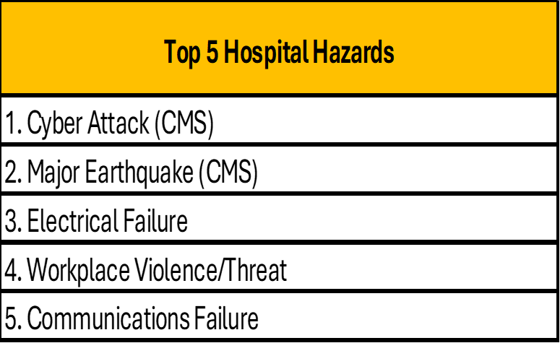
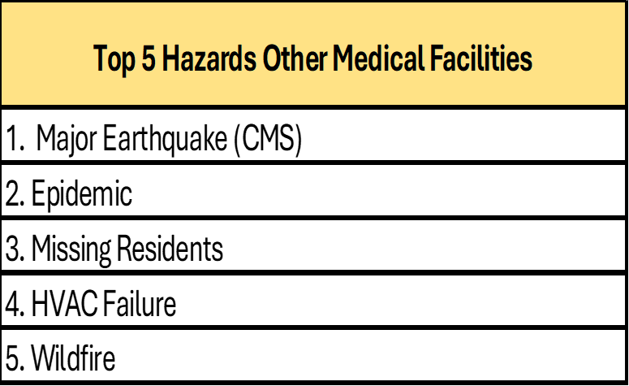
HVA Results Leaving in for reference
Hospitals
Other Allied Medical Services

Slide 13
County Updates:

Slide 14
EMS Updates
Presentation/ Updates:
Presented by: Dr. Gagandeep Grewal –
From the EMS side, is the following:
Epi: numbers for COVID, RSV, and Influenza are on the decline. It was not a bad respiratory season.
However, over ambulance transport volumes (and ED volumes) are high and diversion has been an issue with some hospitals.
Working on updating policies for consistency and accuracy.
TEEX will be doing a their CBRNE training at the Falck Educational institute April 27&28
  Training is free
  MCM/POD planning in September
  Pediatric readiness training in October
  Go to https://teex.org/course-calendar/ (and type in Orange, CA) for registration
FIFA planning likely elsewhere on agenda
  OCFA and Falck are the lead agencies for planning around the US practice in Irvine
  Public practice June 7th
  Iran is said to be playing after all
Disaster planning with SNFs is pending while we move through transitions and FIFA
Notes:
https://www.ochealthinfo.com/ems/aoc

Slide 15
Public Health:
Presentation/ Updates: PowerPoint
Presented by:
PDF May 2026 version
See PDF for County Health Officer Newsletter

Slide 16
HCA Behavioral Health Services Disaster Response
Evidence-informed modular approach to help people of all ages in the immediate aftermath of disaster and terrorism.
PFA is designed to reduce the initial distress caused by traumatic events and to foster short- and long-term adaptive functioning and coping.
Your staff may be called upon to provide PFA in shelters, field hospitals and medical triage areas, acute care facilities (e.g., Emergency Departments), disaster assistance service centers, family reception and assistance centers, homes, businesses, and other community settings.
Rachael and Chad at EMS to coordinate with hospitals
Rachael can provide it at your agency location
No maximum participants required
2 hours (no CEUs provided)
For info or questions contact:
Rachael Ferraiolo, LCSW
Please email for more information rferraiolo@ochca.com
Notes:
Rachael Ferraiolo from Behavioral Health Services with the County has partnered with a contract agency to support the OC Navigator platform. This platform provides resources for disaster preparedness and recovery, including community support, grief assistance, apps, alerts, and mental health information. For more details, please visit: www.ocnavigator.org.
Rachael offered a new topic “Vicarious Trauma” and is willing to come to your facility and facilitate this discussion.

Slide 17
OCHCA Public Information Officer (PIO)
Presentation/ Updates: Julie McDonald
Presented by: NR

Slide 18
Orange County Intelligence Assessment Center (OCIAC)
Presentation/ Updates: PowerPoint
E-Mail: leahluna@ociac.ca.gov
Presented by: Leah Luna
Notes:
More information can be found: https://ociac.ca.gov/default.aspx

Slide 19
HCC/ EMS/HDP:
Presentation/ Updates: Presented by:
HCC:
HAM Radio IP scheduling
HDMT New Date June 11th-12th, 7:00a-4:30p (both days), Location: Training Room 103-b
Needs: Clothes (expired), Role players, expired filters and decon supplies.
TEEX Approved, working with TEEX to schedule
TEEX MGT-439 Peds in Disaster, schedule 3-8-2027
FIFA Planning Activities: Trainings
  Human Trafficking Course (EMS), Virtual Lecture Series (May 28th), HDMT June 11 &12
  HSEEP Course: I have had requests, but don’t know the interest. Update: I have attended the course that now let’s me teach HSEEP. Let me get with CSTI and see about getting this scheduled.
FRC Planning meeting two, scheduled soon.
Notes:
HDMT

Slide 20
Peds Readiness/ Preparedness:
Presentation/ Updates: No Updates currently
Presented by:
Pediatric Disaster Response and Emergency Preparedness training (MGT-439) will be available March 8th, 2027
CHOC hosting October 2026
MGT-439 https://teex.org/class/mgt439/
Upon successful completion, you will be able to:
Recognize the issues likely to arise within the pediatric population during disaster events.
Describe relevant Emergency Management (EM) considerations when planning for the care and management of the pediatric population following a disaster event.
Describe the concepts of surge with specific focus on pediatric implications in a disaster event that are unique to the pediatric population, as well as discuss the impact of those considerations on planning and response efforts.
Discuss effective planning and preparation in addressing the requirements of the pediatric population with Access and Functional Needs (AFN) in a disaster event.
Describe relevant mass sheltering considerations when planning for the care and management of the pediatric population following a disaster event.

Slide 21
Special Topics
FRC Planning meeting two TBD.
Family Reunification Module (ReddiNet) Scheduling second meeting

Slide 22
Trainings/ Exercises/ Presentation/ Lessons Learned/ Best practices
Final Planning Meeting April 7th, 2026
Exercise is April 23rd 8a-12p

Slide 23
Lessons Learned/ AAR/ IP
May 19th AAR/IP
Certificates and AAR to be emailed shortly

Slide 24
Questions?

Slide 25
Orange County Healthcare Coalition(OCHCC)
Sector breakout session
find your Sector Chair

Slide 26

Adjourn/ Thank you for attending/ See you at the next meeting!
July 23rd, 2026

